Slide 1
Signature & Banner Best Practices

Slide 2
Standard Info
Name & title
Corporate, direct, and/or mobile phone
Company logo & website
Company address
Signature
Standards +
Extras
Design Upgrades
Animated logo
Corporate awards (e.g. Inco 5000)
Certification badges
Horizontal orientation with vertical line
Contact Info Upgrades
Support phone number
Social profile icons (linked)
“We’re hiring” link
Meeting link
Survey link

Slide 3
Email Signature Examples

Slide 4
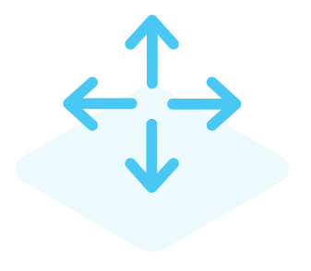
Banner best practices
Size & Resolution 400px by 80px renders well on all devices Best aesthetic: match your signature width 72 dpi resolution recommended
Clear Call to Action (CTA) “Get Your Gift” outperforms “Click Here”
Add Movement GIFs are supported & tend to generate more engagement Moving banners really catch the eye (see next slide for examples)
Remember:
It’s still an ad so treat it like one

Slide 5
Example Banner Campaigns
Events
News
Content
Recruiting
Reviews
Surveys

Slide 6
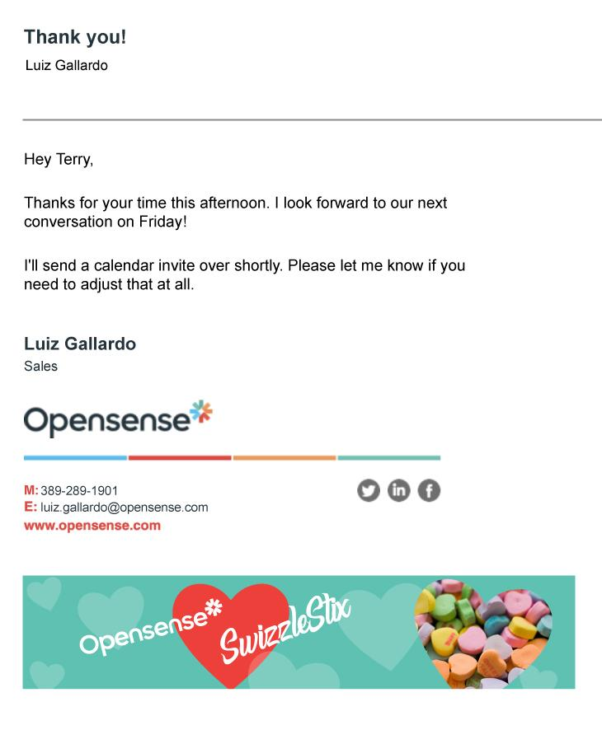
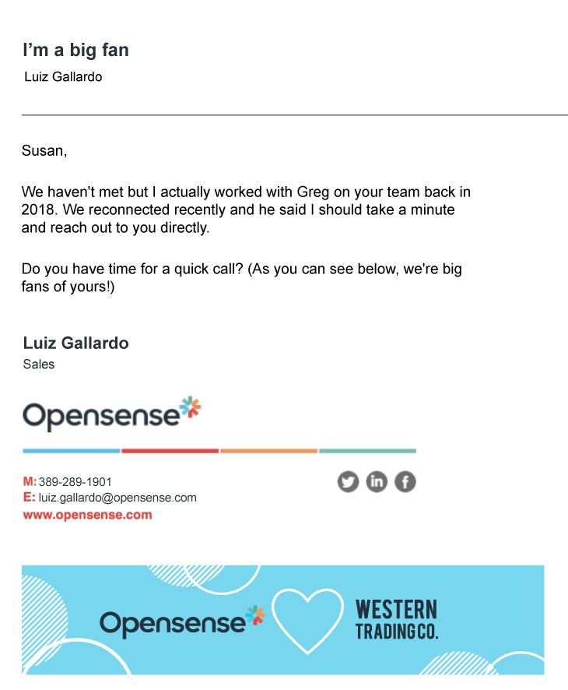
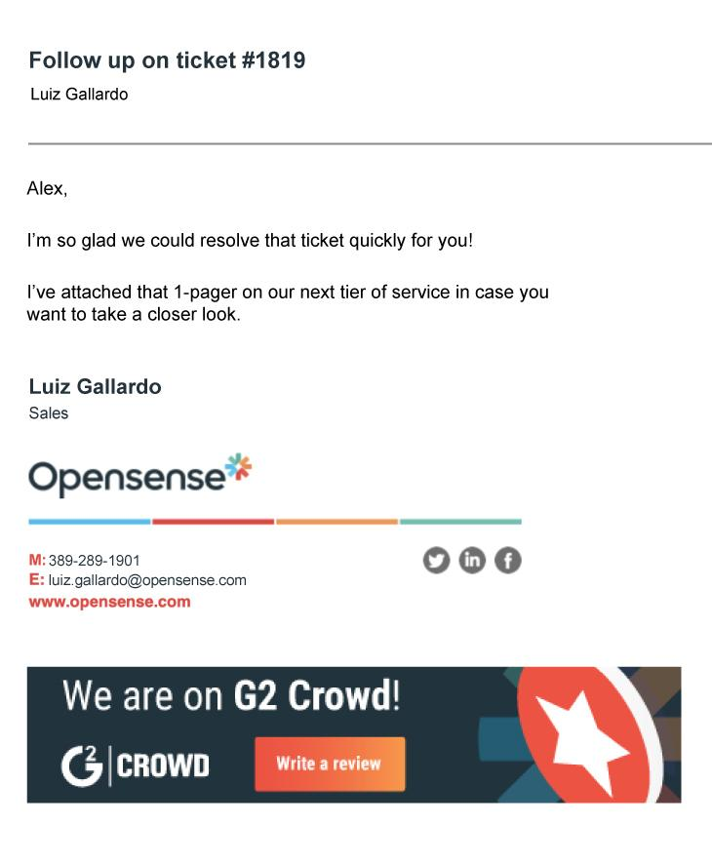
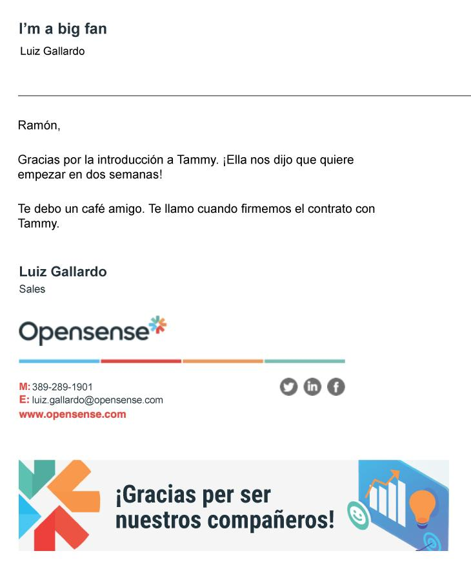
Personalized Email Banner Campaigns (+ ABM)
Prospect at Target Account
Prospect at Another Target Account
Current Customer
Partner Based in Spain

Slide 7
^{Questions?}
Contact support at help@opensense.com

