Slide 1
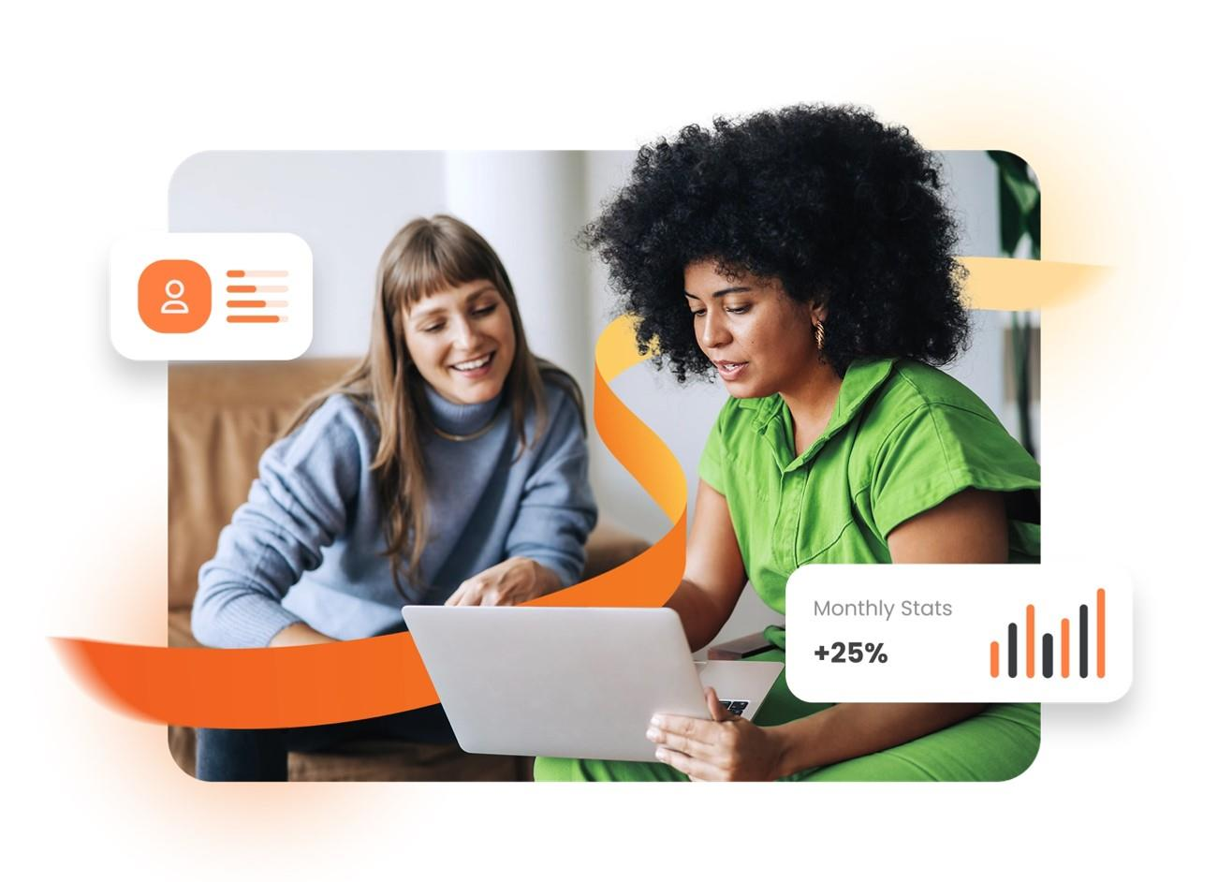
Powering the world of work
Performance Management Masterclass
Presented by OneAdvanced – Performance & Talent Customer Success Team

Slide 2



Introductions
Stuart Snowden
Juliet Cox
Binita Malde
Customer Success Manager
Customer Success Manager
Customer Success Manager
Give Stuart
some Feedback
Give Juliet
some Feedback
Give Binita
some Feedback

Slide 3
Agenda
01
What is Continuous Performance Management?
02
What matters to employees, managers and HR?
03
Continuous Performance Management Principles
04
Embed a Continuous Performance Management Culture
05
Guidance & Resources

Slide 4
What is Continuous Performance Management?
An ongoing interaction between an employee and manager, focused on developing the individual to achieve high performance for the benefit of themselves and the organisation

Slide 5

How continuous performance management benefits me
Employees
Understand my near-term goals
Frequent feedback from peers
Regular airtime with my manager
Managers
Uncover blockers in my teams’ work
Ensure my team are aligned to our mission and values
Provide scalable development plans
HR / Leadership
Enable data informed decisions about pay and succession
Identify current training needs
Consistently recognise high or low performers

Slide 6
Unlock Continuous Performance Management
Annual Appraisals
Continuous Models
Annual appraisals do not improve performance. In 30% of cases they can be a detriment (psychological bulletin)
Organisations are 1.4x more likely to meet financial targets (Gallup)
13% increase in employee engagement (Gartner)
95% of managers are unsatisfied with the outcomes (CEB)
1.7x more likely to delight customers (Deloitte)
75% of employees see them as being unfair (Towers Watson)

Slide 7
Continuous
Performance Management Principles

Slide 8
4 core principles
Real-time feedback
Agile objectives
Meaningful coaching conversations
Data driven decisions

Slide 9
Appreciated
Informal and frequent
Authentic, supportive
Developmental, future-focused
Given in the moment or soon afterwards
Feedback Settings
Real-time Feedback
For optimum performance and motivation
  individuals should receive feedback at least every 2 weeks
  the ratio of positive to constructive feedback should be 3:1

Slide 10
Customer A - Example Scenario
This customer has an entrepreneurial and growth mindset culture.
A science-based business, where each staff member is encouraged to own their own ‘development evidence’.
This customer ensures that feedback is part of the business DNA and is introduced from the point of joining the business.
Rolled out with Feedback using their own EVA (Evidence-Value-Action) model.
The Virtuous Cycle (CPM) - Conversations and Goal Setting were secondary, but feedback (given and received) feeds into development conversations and agile goals.
Regular management workshops are held to discuss the relationship between CPM behaviour and performance.
Professional Services
325 Users
Customer Since Sept 2022

Slide 11
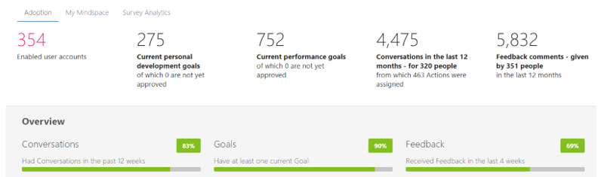
Customer A – Adoption Stats 2 years after implementation

Slide 12
Agile & flexible
Near-term
Aligned to organisational goals
Collaborative
Developmental
Setting Effective Performance Objectives – SMART and the 5 A’s
Performance Objectives

Slide 13
Individualised
Growth-oriented
Actionable within defined timelines
Motivating and challenging
Supports long-term goals
What are Personal Development Objectives?
Personal Development Objective Options - Help | Performance & Talent
Personal Development Objectives

Slide 14
  Dedicated reflection time
  Collaborative goal setting
  Feedback & recognition
  Development planning
  Performance improvement
  Conversation Settings
Meaningful coaching conversations

Slide 15
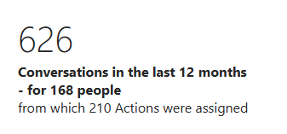
Customer B – Example Scenario
Key Performance Indicators:
  Mandatory monthly conversations
  Leveraging different conversation types
  Standard discussion prompts
  Placing objective reviews at the centre
  Redefining the purpose of conversations
To achieve this, the customer:
  Utilised our Communication Plan
  Created an intranet site with guidance
  Supported managers with training & time
  Created a "power" conversation (15-20 mins)
  Championed an internal focus group
  Updated induction procedures
Housing Association
200 employees
Launched P&T June 2024

Slide 16
  Holistic view of performance, not assumptions
  Steer outcomes to meet strategic goals
  Build succession plans and identify talent
  Understand skills gaps and plan accordingly
  Make equitable decisions on pay & reward
Data driven decisions
Optimise performance data with Talent Snapshots to conduct:
  On-Going Reflective Reviews
  Performance Reviews
  Employee / Manager Assessments
  & More!
Learn more via our Talent Snapshot Video

Slide 17
Continuous performance management in action
Organisation sets its key strategic goals. Employees set and track agile, aligned objectives in the system
Rich performance data builds up in the system. This can be served up to enable data-led decisions based on fact, not opinion
Frequent feedback is shared with ease in the system, building a developmental feedback culture
Employees and managers use the system to set frequent, meaningful coaching conversations

Slide 18
Embed a Continuous Performance Management Culture
Culture is not just about the perks and the ping-pong table. It's about the shared values, beliefs, and behaviours that drive how people work together and achieve results.
Simon Sinek

Slide 19



Drive Adoption Culturally
vc
Culture

Slide 20
Drive Adoption Culturally
Management
Buy In
vc
Create a video with leadership emphasising the move to continuous performance.
Culture

Slide 21
Drive Adoption Culturally
Management
Buy In
Easy access to
guidance
vc
Add links to an intranet site with useful documentation in the system. Make it easy!
Culture

Slide 22
Drive Adoption Culturally
Management
Buy In
Easy access to
guidance
Clearly articulate performance expectations i.e. minimum & maximum number of objectives, levels of feedback and conversation cadence.
Also consider how your organisation defines and measure talent and communicate this.
vc
Communicate
Expectations
Culture

Slide 23
Drive Adoption Culturally
Management
Buy In
Easy access to
guidance
vc
Communicate
Vision
Include Performance & Talent in new starters' inductions for recurring check-ins
Culture
New Starter
Integration

Slide 24
Drive Adoption Culturally
Management
Buy In
Easy access to
guidance
vc
Communicate
Vision
Implement a quarterly performance development day – make it a quarterly focus
Culture
New Starter
Integration
Performance
Development Day

Slide 25
Drive Adoption Culturally
Management
Buy In
Easy access to
guidance
Share performance KPIs across the organisation to foster transparency and alignment.
Identify high/low engaged departments and encourage internal ambassadors.
vc
Communicate
Vision
Culture
New Starter
Integration
Performance
Development Day
Utilise
Dashboards

Slide 26
Drive Adoption Culturally
Management
Buy In
Easy access to
guidance
vc
Communicate
Vision
Highlight achievements positively with soundbite videos or case studies
Culture
New Starter
Integration
Celebrate
Successes
Performance
Development Day
Utilise
Dashboards

Slide 27
Drive Adoption Culturally
Management
Buy In
Easy access to
guidance
vc
Communicate
Vision
Form a cross-sectional "power group" for regular feedback
Culture
Feedback
Power Group
New Starter
Integration
Celebrate
Successes
Performance
Development Day
Utilise
Dashboards

Slide 28
Drive Adoption Culturally
Management
Buy In
Easy access to
guidance
Commitment
To Feedback
vc
Communicate
Vision
Ensure consistent feedback from senior leadership and managers at all levels
Culture
Feedback
Power Group
New Starter
Integration
Celebrate
Successes
Performance
Development Day
Utilise
Dashboards

Slide 29
Drive Adoption Culturally
Management
Buy In
Get
Social
Easy access to
guidance
Commitment
To Feedback
vc
Communicate
Vision
Use internal social sites to create an interactive channel to share
Culture
Feedback
Power Group
New Starter
Integration
Celebrate
Successes
Performance
Development Day
Utilise
Dashboards

Slide 30
Customer C - Example Scenario
Looking to make a seismic shift in their approach to performance management
Moving away from a paper-based, annual review with an informal mid-year conversation to a structured data-driven quarterly review
Previous approach was arbitrary with goals set at the start of the Financial Year and generally retro-fitted at the year-end review to reflect the priorities
Ratings were forced into a bell-curve despite individual and team performance
Now performance is reviewed quarterly and ratings reviewed on a rolling 4 quarter basis
Managers have discretionary bonus pots to further recognise high performers within their teams
Data on the system is used to review contribution to team goals, feedback received, quality of feedback provided to colleagues, agreement on personal development goals for the next quarter
Financial Services
Circa 8,000
Customer since October 2017

Slide 31
Customer D - Example Scenario
This customer firmly believes that their staff members are their most valuable assets and wanted a system to provide the tools to support performance development for a largely mobile workforce.
Performance behaviours are introduced at the first onboarding meeting with a steady emphasis on best practice throughout the work life-cycle.
They are able to identify those ready for progression and act on that in a timely way, rather than wait for an annual review.
The CEO takes a personal role in spot-checking goals for quality and consistency and demonstrates performance behaviours from the top.
Construction
85 Users
Customer Since September 2019

Slide 32
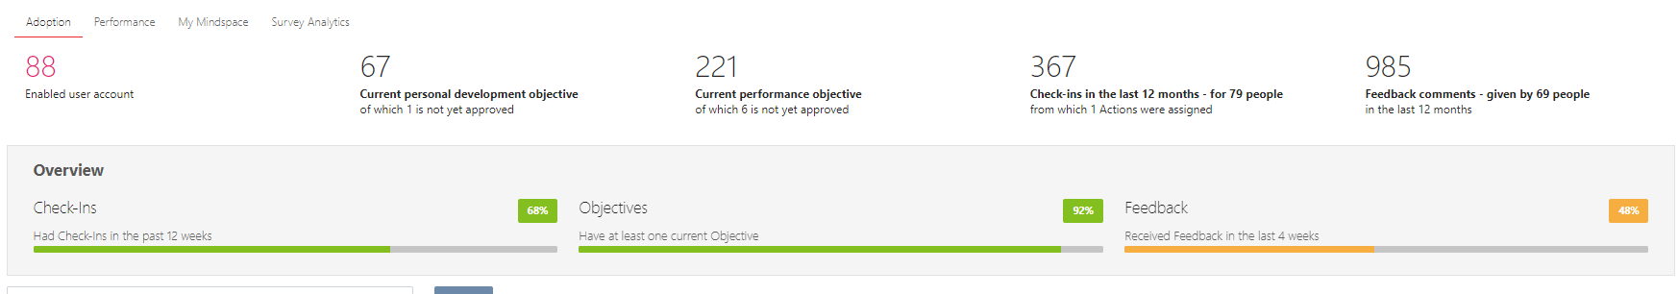
Customer D – Adoption Stats 5 years after implementation

Slide 33

Guidance & Resources
Product Hub: Take a tour of our comprehensive guidance for admin, employees and managers guidance here.
Training and Communications Materials: Review our handy editable resources here including our communication plan here.
Customer Success Support: Please contact our team at cr.clarissa@oneadvanced.com.
Technical Support Team: Register or login to our support portal here.

Slide 34
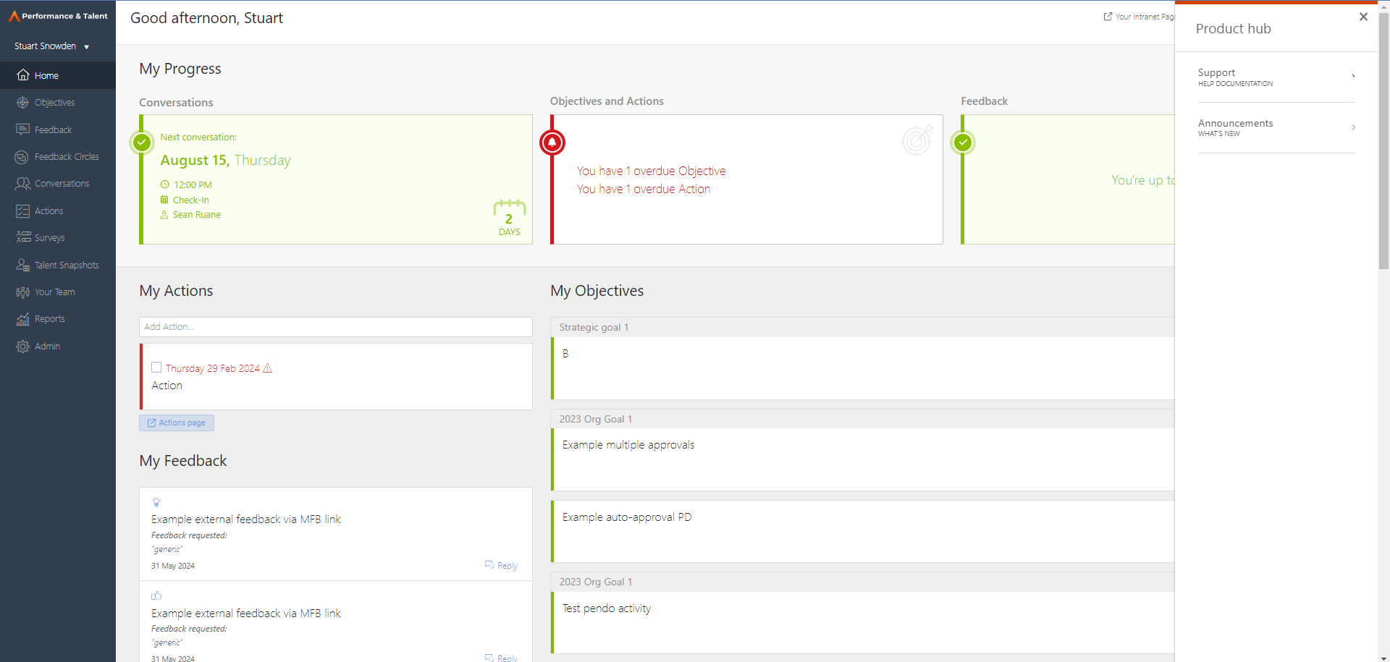
Guidance & Resources

Slide 35
Thank you for your time.

Slide 36



Connect with us
+44(0) 330 343 4000
www.oneadvanced.com
hello@advanced.com

