Slide 1
Salesforce MFA
Notes:
Salesforce has rolled out Multi-Factor Authentication across every organization in their platform. As of tomorrow, March 16 our Organization will enforce this requirement. Let’s highlight a few key points for this rollout. [SLIDE CHANGE]

Slide 2
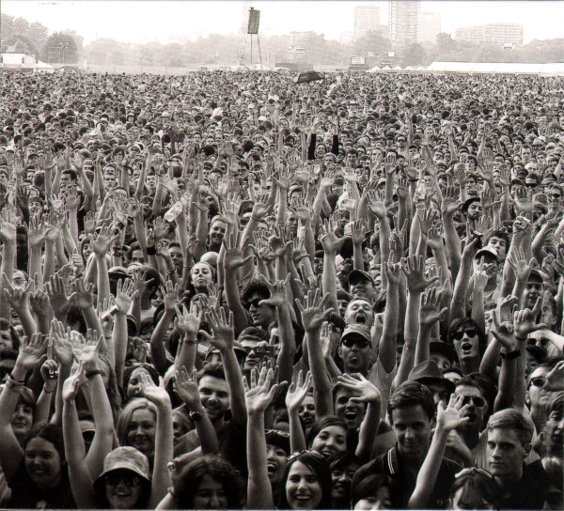
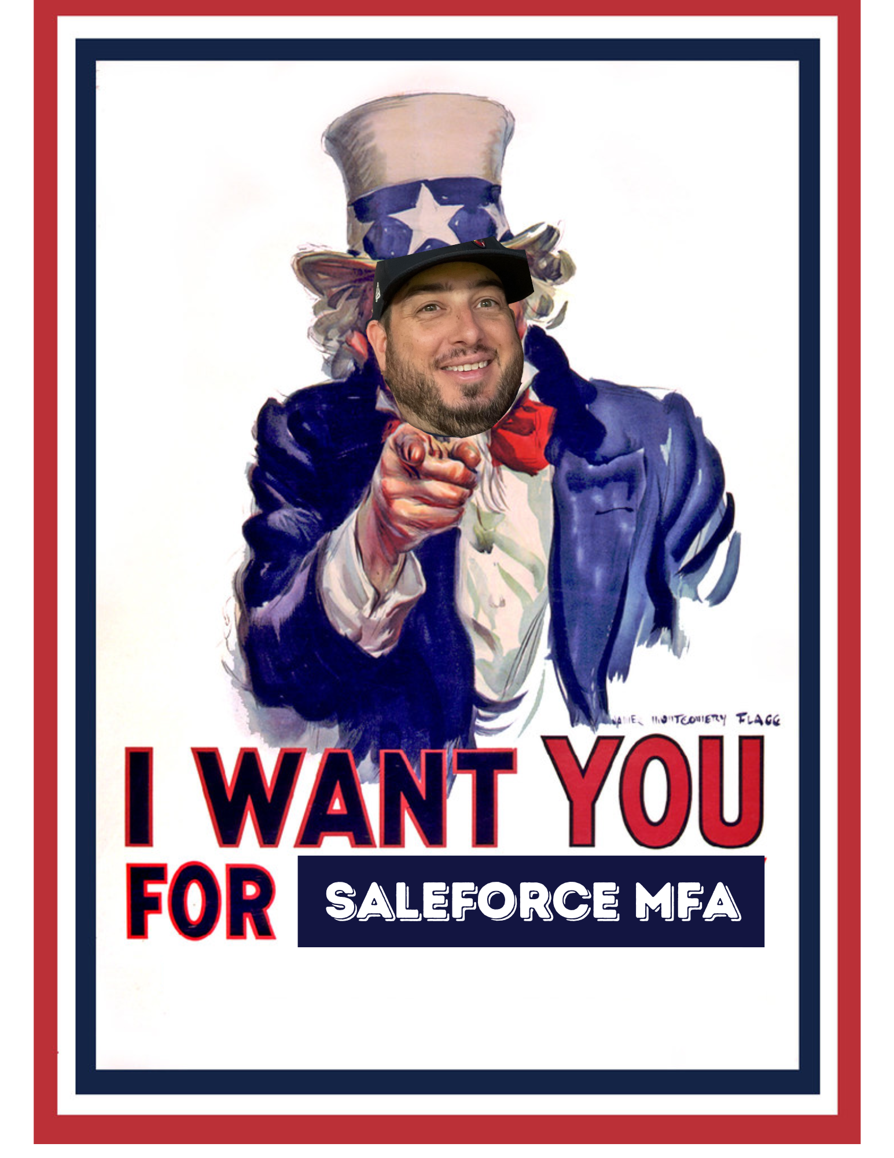
Who, what, when, where & how?
Notes:
Who does this affect? Everyone that has a Salesforce account
What do you need to login? Your Salesforce username, password, and the Salesforce Authenticator app on your phone
When does this take effect? Tomorrow, 12AM is when the policy becomes enforced
Where will you see this? On your computer during the login process
How will it get set up? Everyone, that has not already completed the process, and will give a huge shoutout to the 58 team members that have already set up MFA, will be prompted to complete it tomorrow morning.

Slide 3
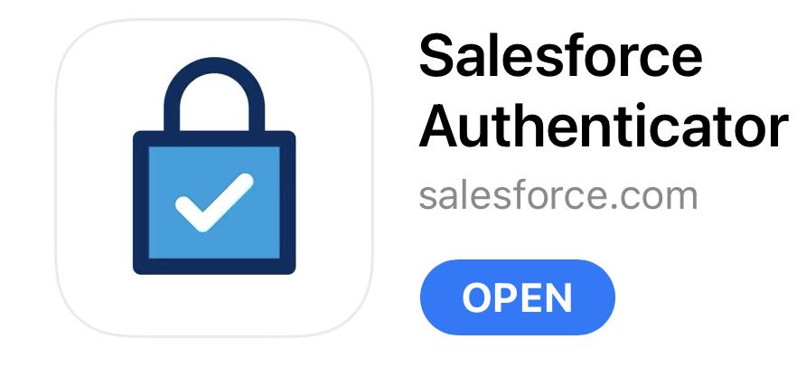
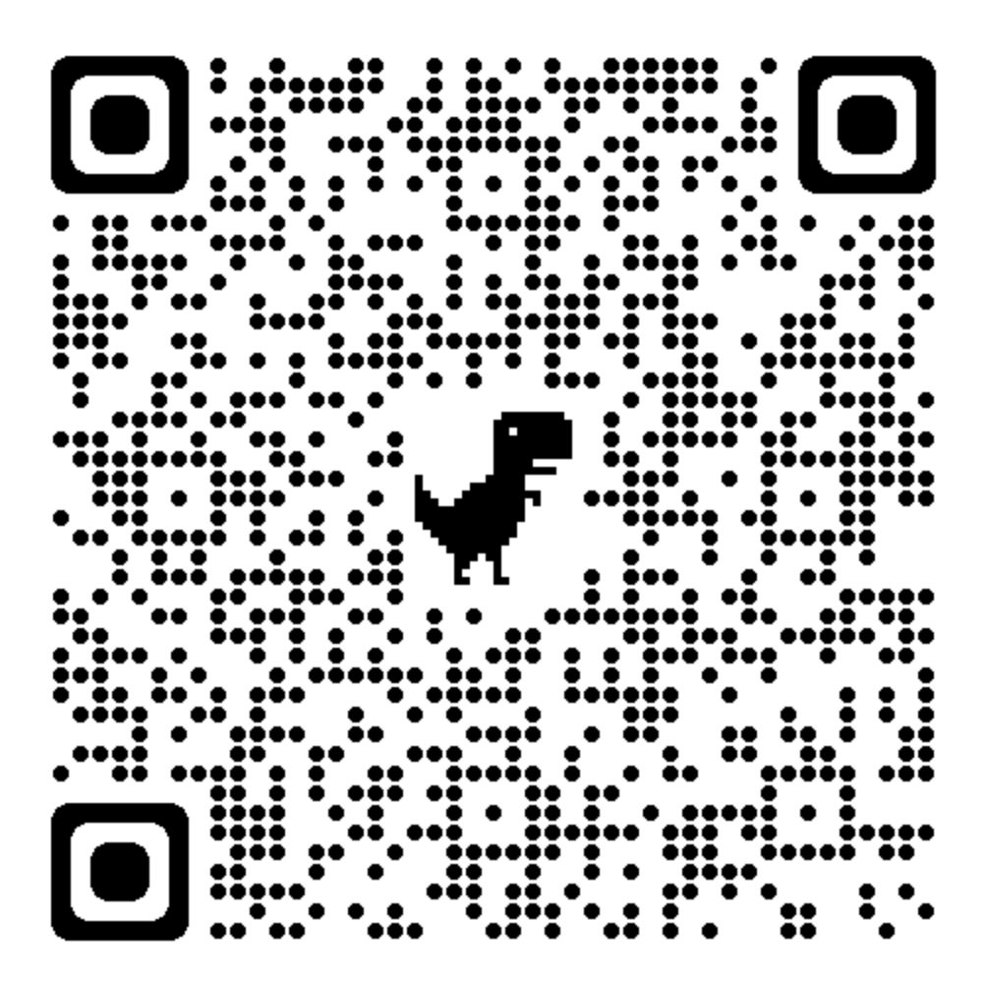
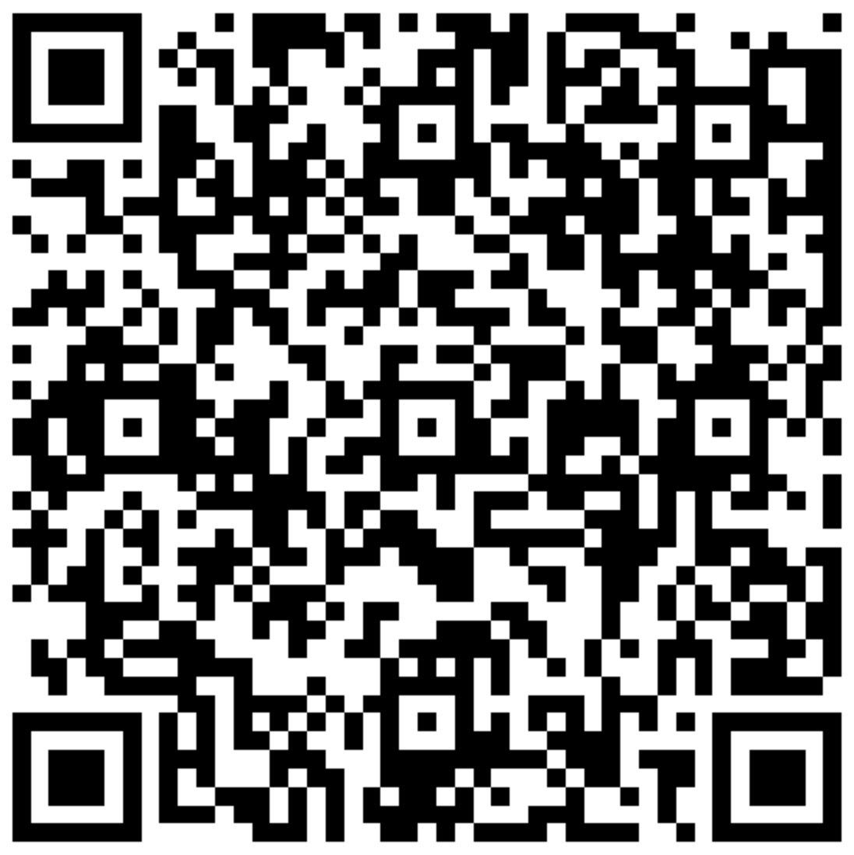
Salesforce Authenticator App
Salesforce Authenticator is an app that adds an extra layer of security to online accounts by providing out-of-band authentication.
The app sends push notifications for logins and critical actions, which can be approved or denied with a tap.
The app can use location services to automatically verify from trusted locations and save trusted requests for later. It also provides verification codes as a backup authentication method.
Google Play Store
iOS App Store
Notes:
The Salesforce Authenticator app is a provided for free from Salesforce to download on your personal mobile phone/device/smartphone, whatever name you want to give it these days.
Through a few team members that completed the process, the whole set up should only take 60-90 seconds but can take a little longer.
For anyone that is having issues, Nicole will take it away with how we will support you…take it away Nicole

Slide 4
Salesforce MFA Office Hours
Thursday Morning, March 16⋅7C/8E (AM) – 10C/11E (AM)
Join Zoom Meeting
ID: 89075660565
Passcode: 046597
Meeting host: nicole@progresslearning.com
Join Zoom Meeting: Join Salesforce MFA Office Hours
Notes:
Greetings Staff,
We have open office hours Thursday morning from 7:00 a.m. to 10:00 a.m. central, please feel free to hop in if you have any questions or issues regarding Salesforce Multi-Factor Authentication.
IT will be attaching the Zoom Meeting Link in the #announcements channel tomorrow morning.

Slide 5
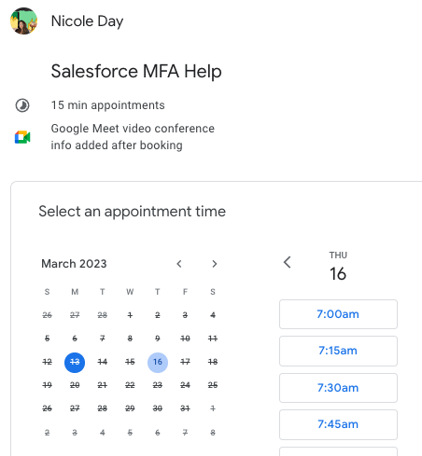
Nicole Appointment Availability
Book 15 minutes
Availability 7am-4pm CT (8am-5pm ET)
Google Meet
Notes:
If you’d like one-on-one support I am available by appointment tomorrow from 7am-4pm central.
Nicole’s appointment schedule will also be included in the #announcements channel tomorrow morning.

Slide 6
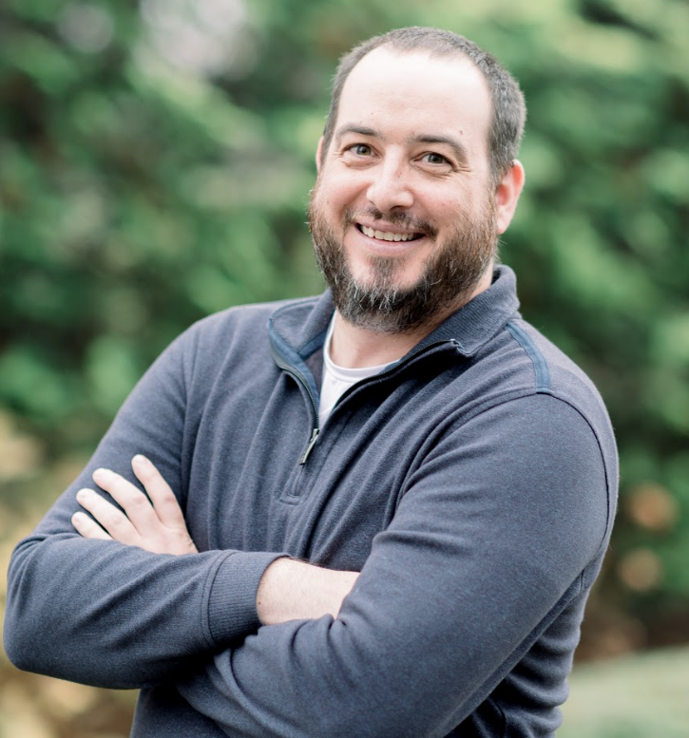
IT Team
Nicole Day
IT Helpdesk
Sam Gunter
IT Manager

Slide 7
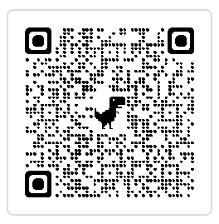
Helpdocs Article in Command Center
Setting up Salesforce Multi-Factor Authenticator

Slide 8
​IT Instruction Video to assist with setting up Salesforce MFA​
Notes:
This video is for reference if anyone needs it handy, but also is linked to the article on the previous page in our Command Center on Helpdocs

Slide 9
If you have any issues with setting up this, please reach out to Nicole on Slack for direct support.
You can also use the button below to create a case through the staff site with Topic: IT Helpdesk > Category: Services > Sub-Category: Salesforce for case capturing.
Create a Case
Notes:
Quick reminder that our helpdesk form is always available.
For this specific issue, we are asking that you follow the Topic, Category, & Sub-Category to submit by so that your request can be directed to Nicole first. If you chose a different set of answers, our response time may be delayed more than anticipated.

