Slide 1
Wonderment Review
<Customer Name>

Slide 2
Meet the Team
Hi, Welcome!
Agenda
Tracking Page & Metrics Review
Customer Communications Review
Next Steps & Recommendations
BFCM Prep
Notes:
Blake intro

Slide 3
Your Wonderment
Tracking Page

Slide 4
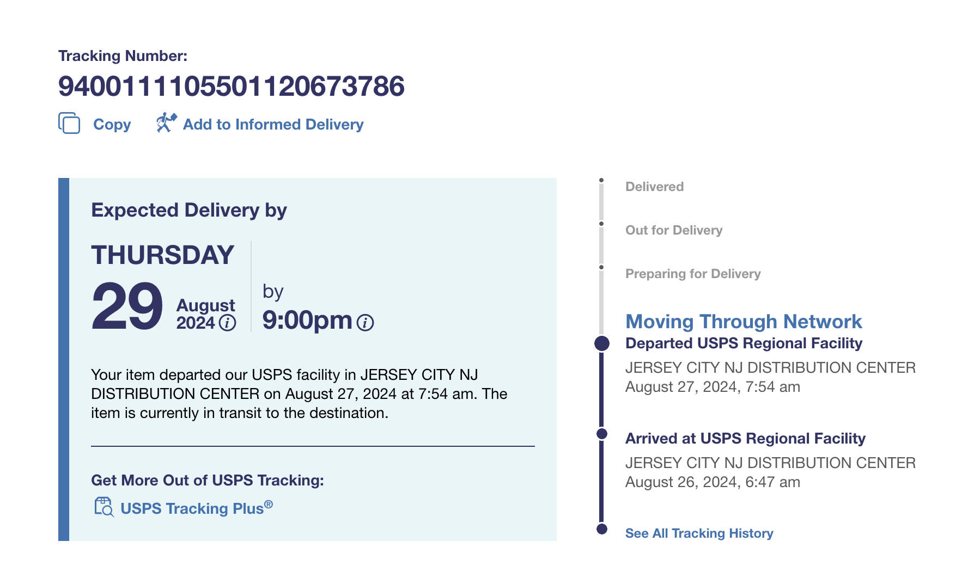
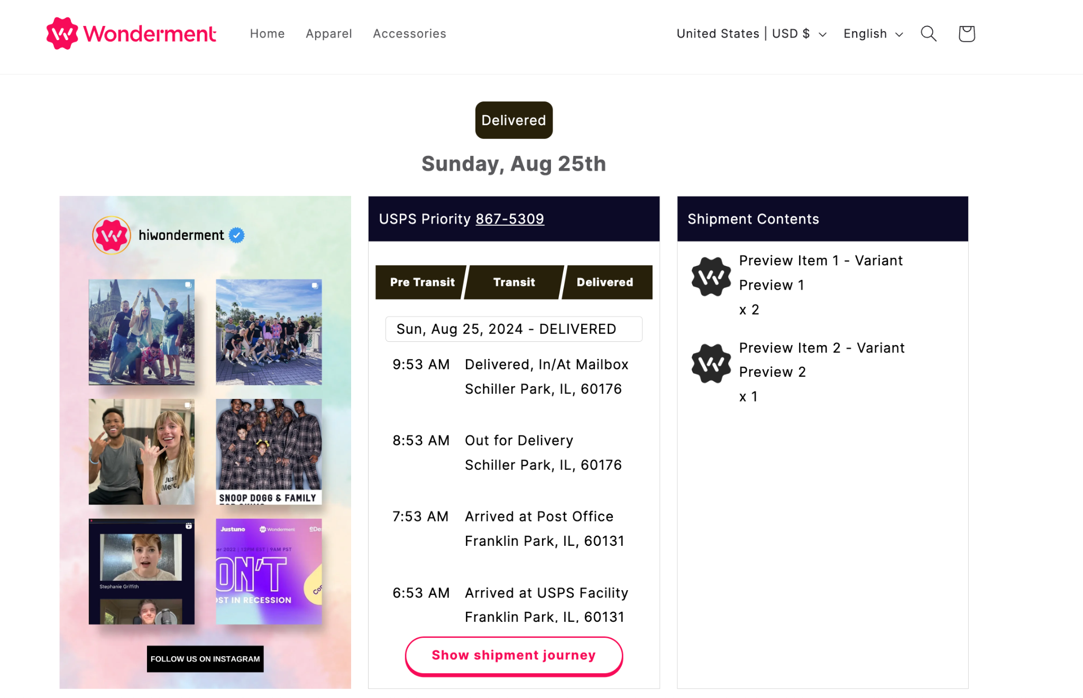
Your Post-Purchase Experience Glow Up
Before
After

Slide 5
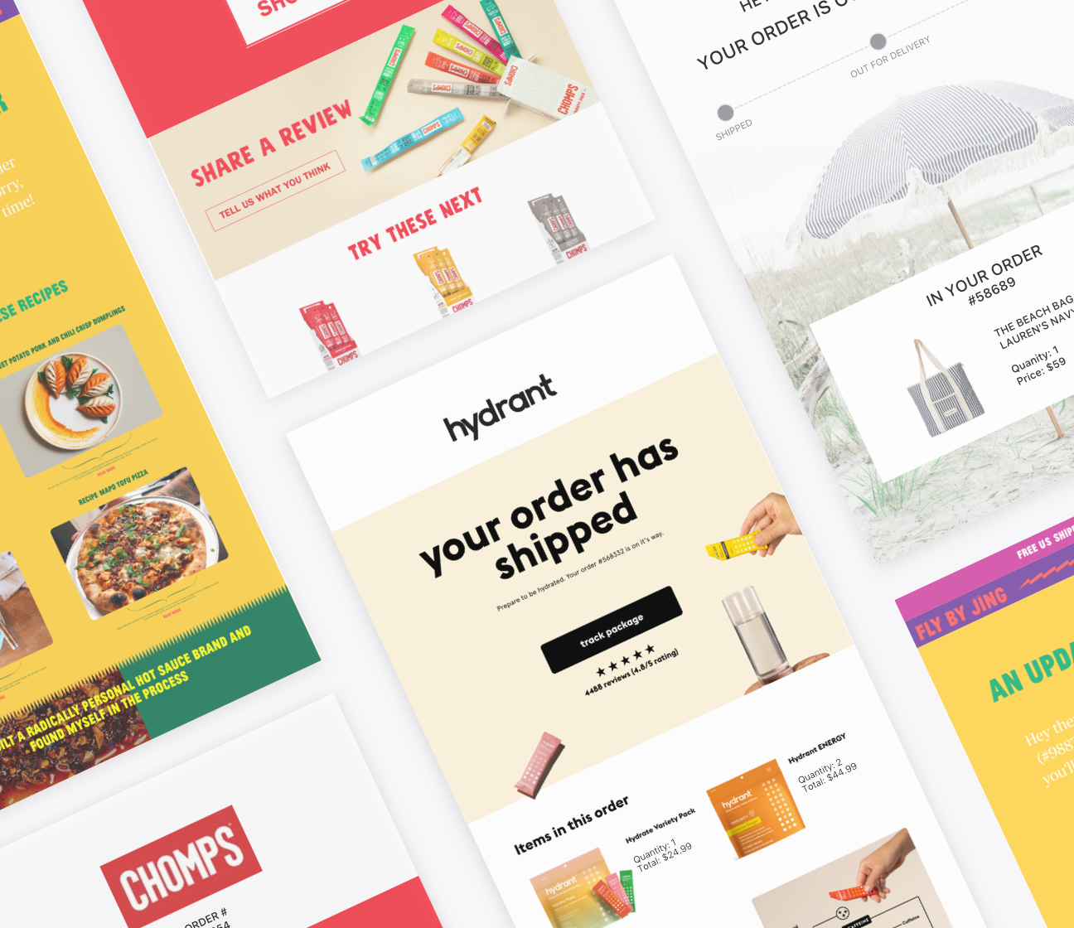
Wonderment Tracking Page
In The Last 30 Days | Customer | Benchmark
Tracking Page Views
Tracking Page Views to Orders |  | 1.2x - 4x
Tracking Page Revenue
Tracking Page Conversion Rate |  | 0.7-1%

Slide 6
Optimizing Your Customer Communication Channels

Slide 7
Wonderment Data-Driven Customer Comms
Since Launch | Customer | Benchmark
Email Open Rates |  | 60-80%
Email Click-Through Rates |  | 10-20%
Email Revenue
SMS Click-Through Rates |  | 50-75%
SMS Revenue
*5 Days Opened or Clicked Email

Slide 8
Recommendations

Slide 9
Additional Optimization Recommendations
Add Wonderment Delivery Feedback surveys
Wonderment Delivery Promise
Set up scheduled reports for key metrics or set up internal alerts in Klaviyo for key potential issues.
Check that the internal alerts are set up to send to the correct person and that the notifications have been accepted
Integrations check
Prep for BFCM!

Slide 10
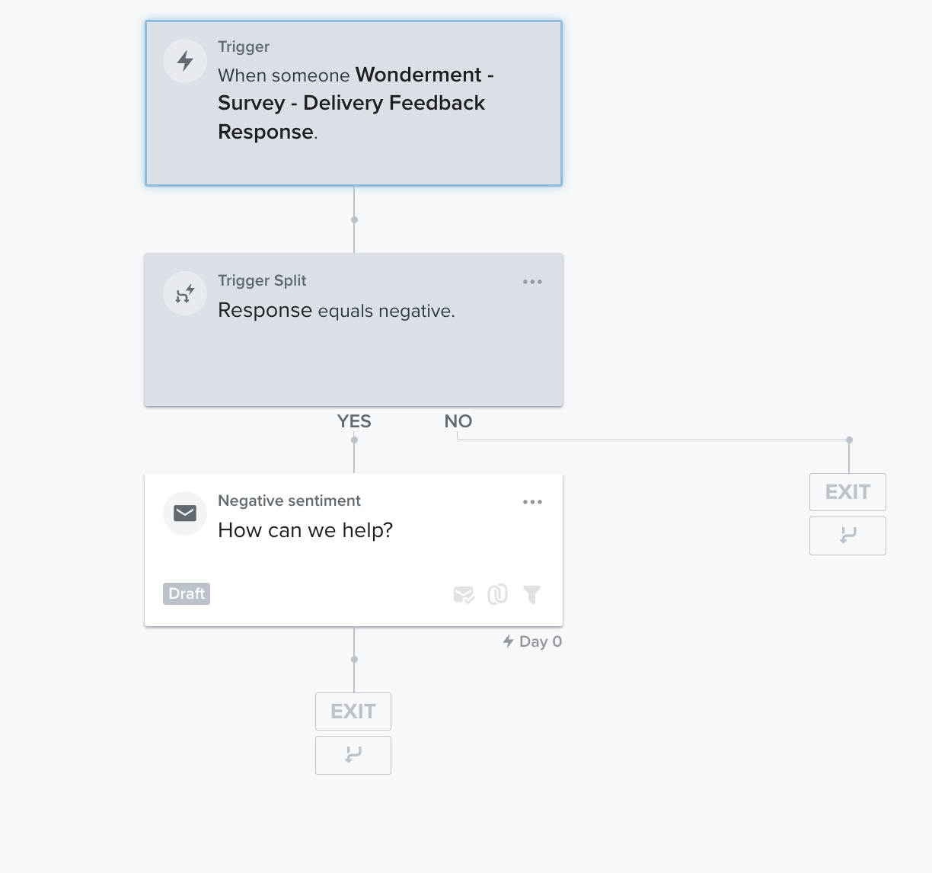
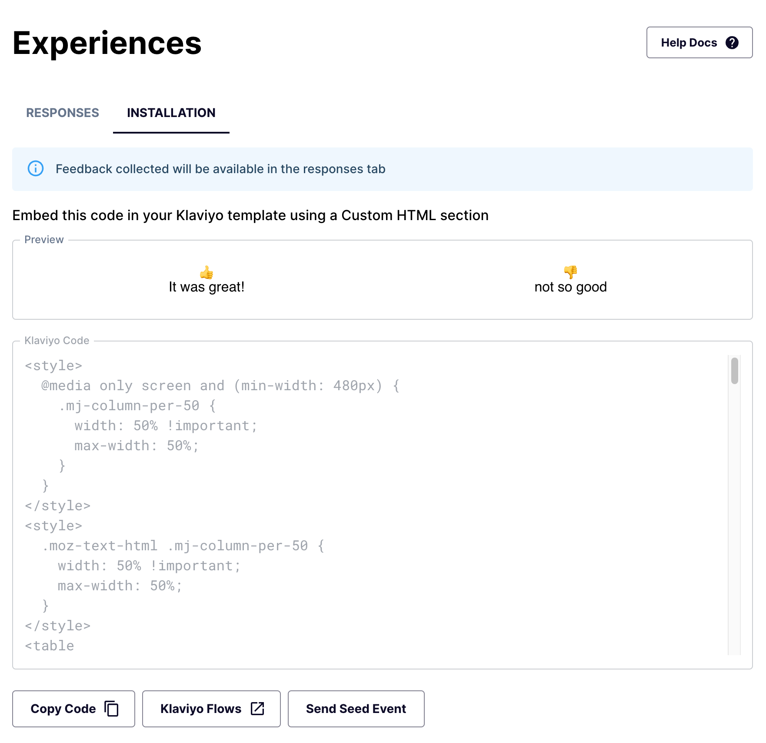
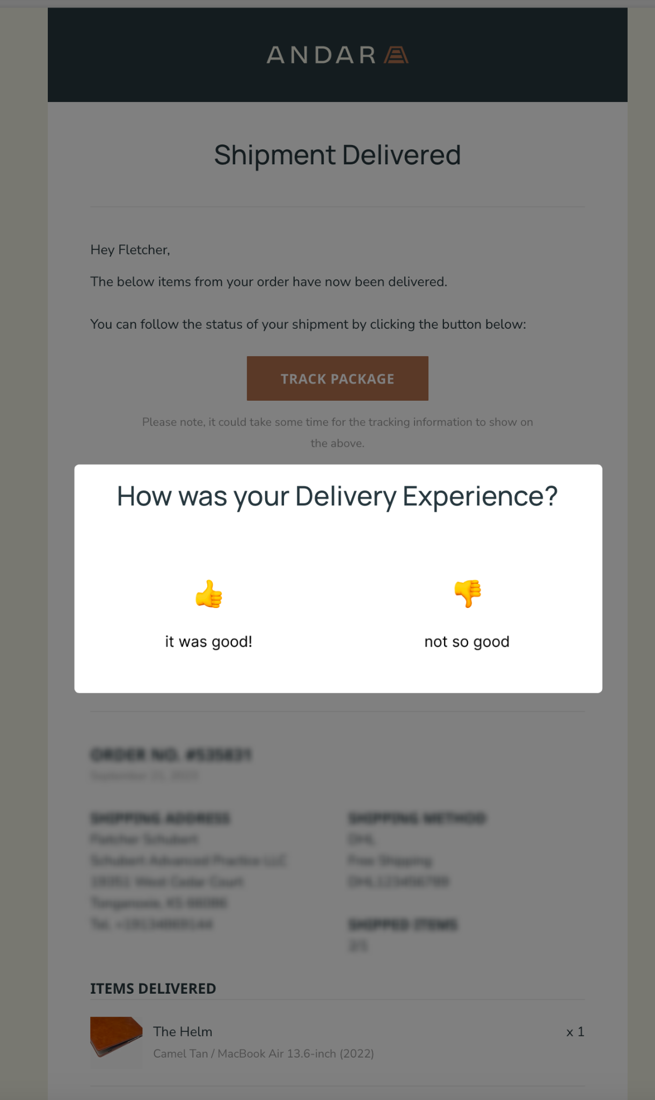
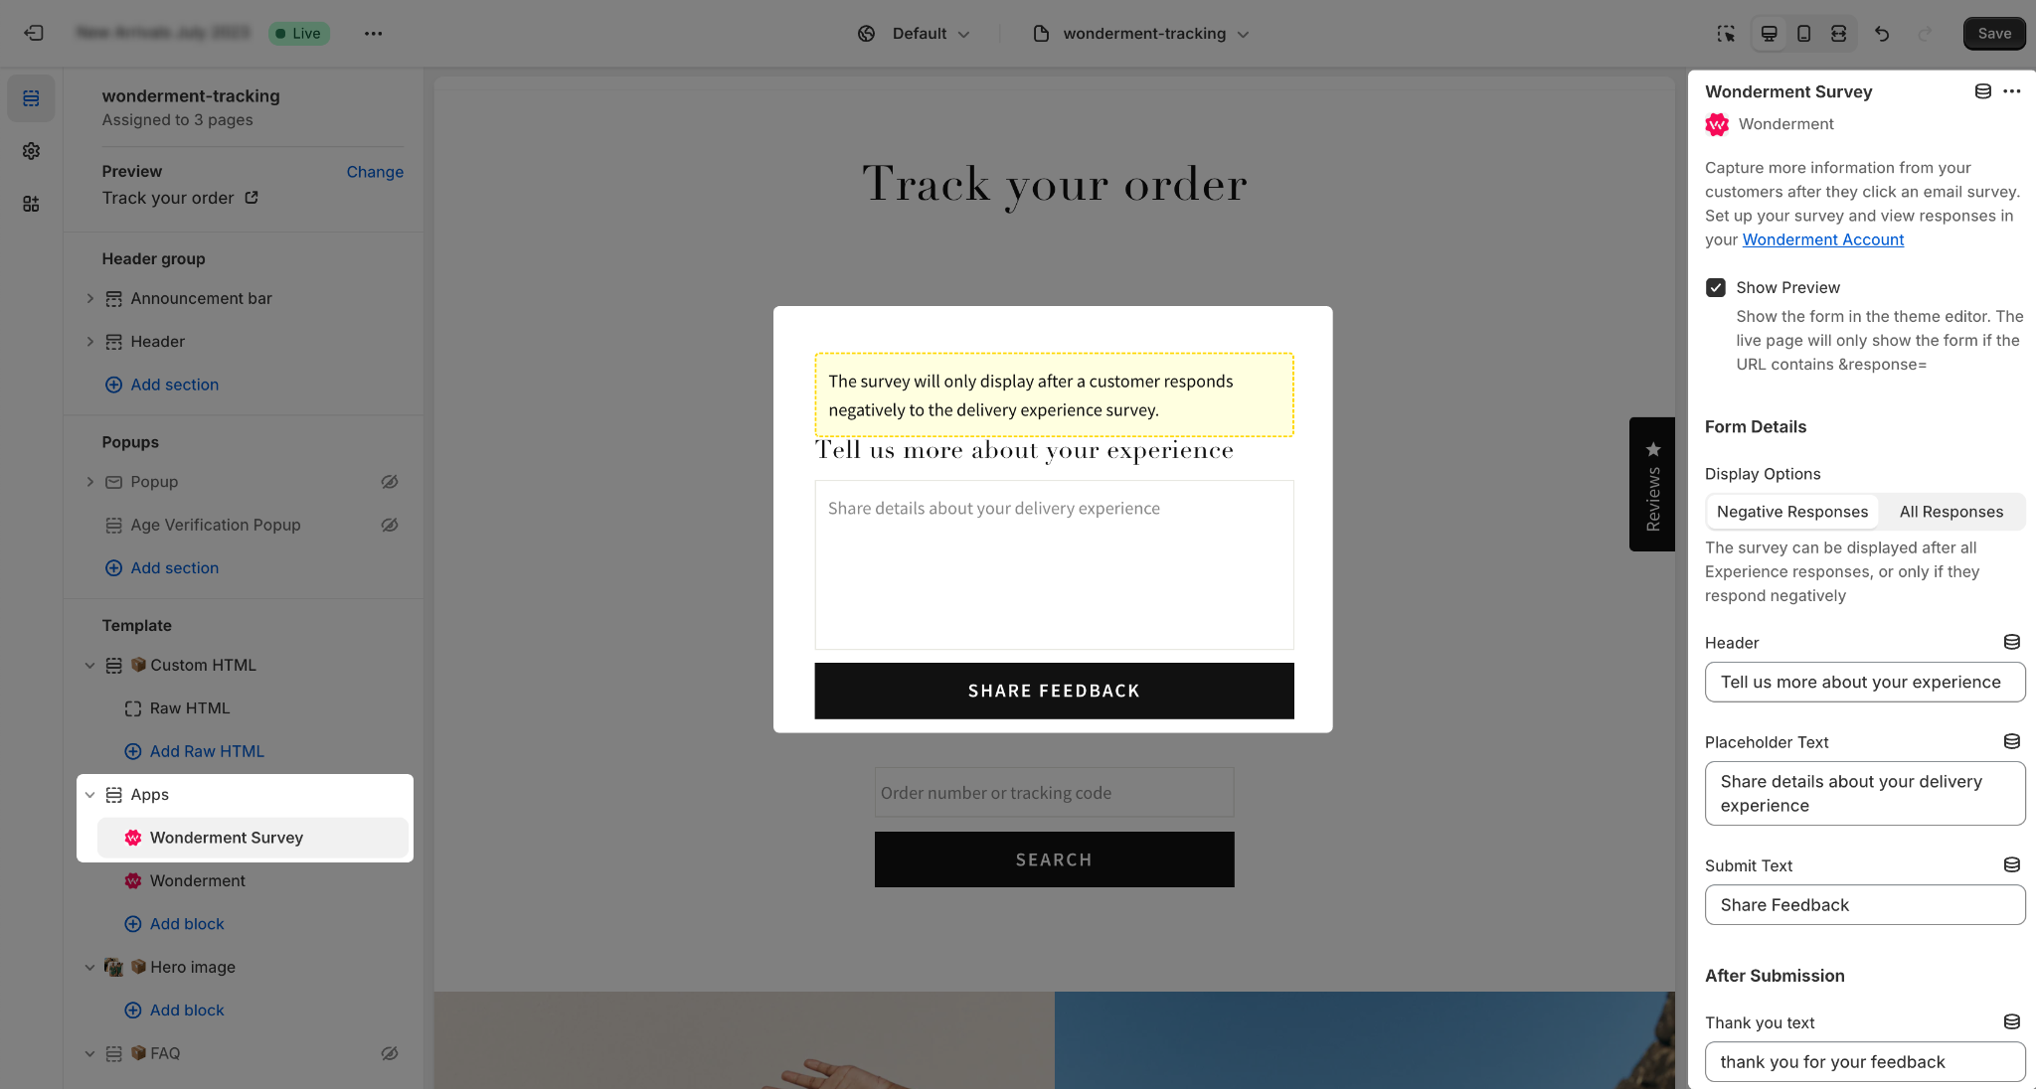
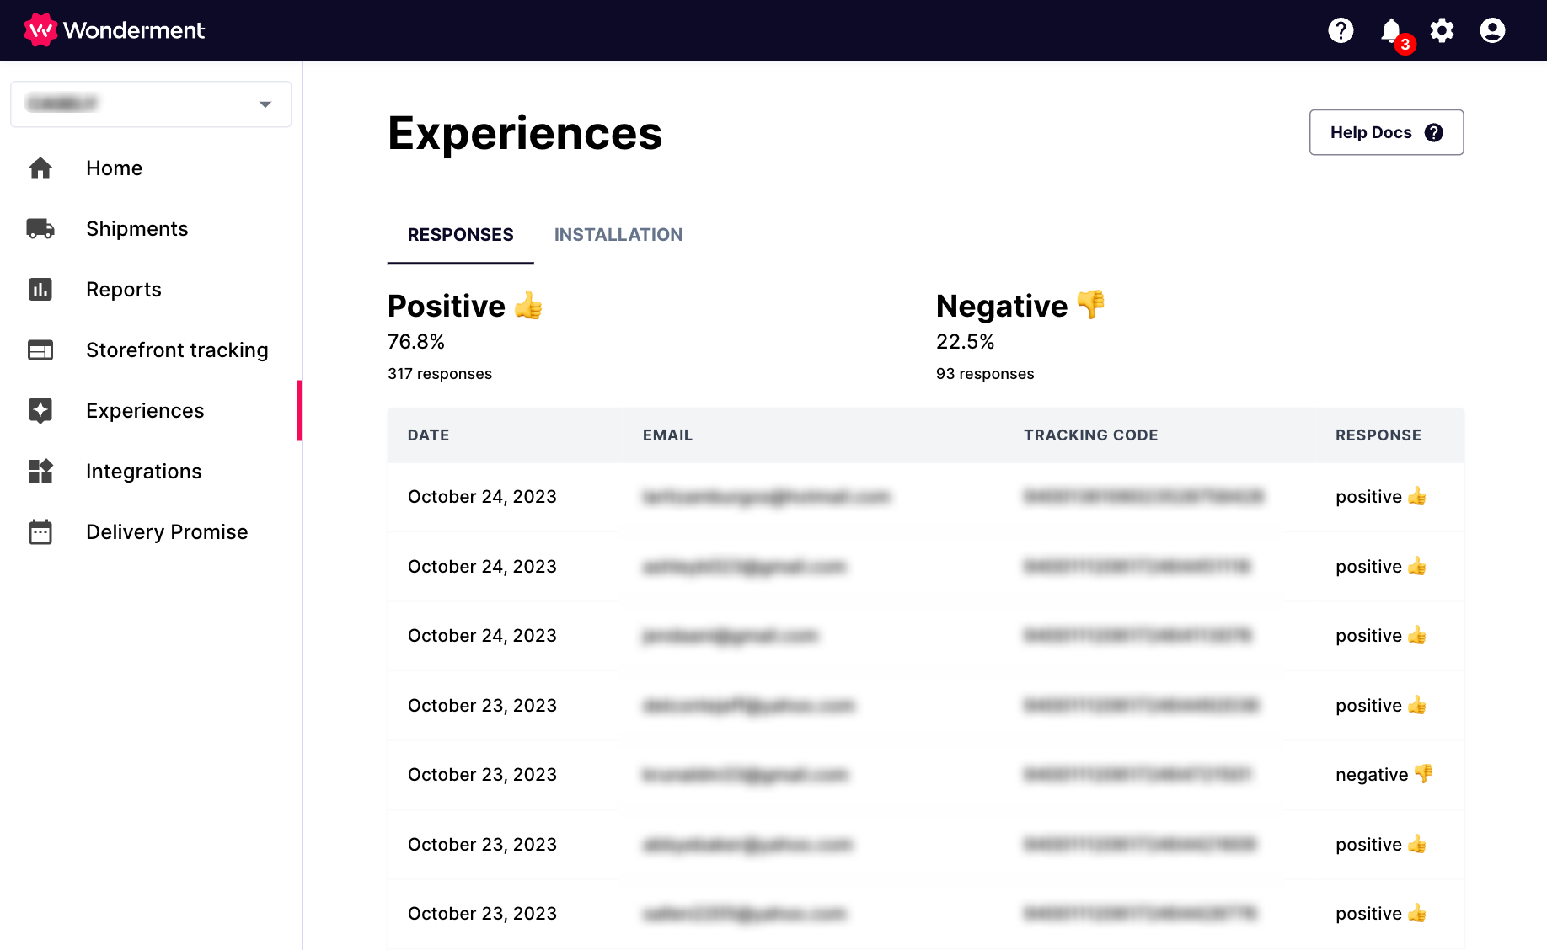
Delivery Experience Surveys

Slide 11
Black Friday / Cyber Monday
Post-Purchase Checklist

Slide 12
September BFCM Prep
Ensure you have
All 6 shipping emails set up
Transactional SMS (Klaviyo, Attentive, PostScript)
Add SMS / Email marketing capture to Storefront Tracking pages
PostScript
Attentive
Klaviyo
Set up Reporting for Q4
Service Level + Time in Transit - monitor for packages in transit longer than carrier SLA
Stalled Shipments
Returned / Damaged Packages
Packages not Picked Up in X days

Slide 13
October BFCM Prep
Audit all internal notifications to ensure all relevant information is included - confirm with CX team if any additional information would be helpful
Add banner or verbiage to transactional emails and tracking page FAQs about holiday shipping timelines
Decide on LTOs and Bundles that should be added to the tracking page for upsell/cross-sell opportunities

Slide 14
First Week of November
Change verbiage above products on tracking page to “Great Gift Ideas”
Add LTOs and Bundles to the tracking page for upsell/cross-sell opportunities

Slide 15
BF Week!
Add banner to tracking page about last shipping dates for holidays
Ensure relevant sales & promotions are shown on tracking page
Add “Great Gift” ideas banner to transactional emails, linking to gift guide collection on store

Slide 16
Cyber Monday Week!
Change verbiage above product block to “Last Minute Gift Ideas”
Add gift cards and other fast-shipping options to the tracking page
Add “last day for holiday shipping” dates to the tracking page

Slide 17
Post-Holiday
(late December/January)
Revert verbiage above product block to prior text (usually “You May Also Like”)
Remove holiday shipping timeline information from transactional messaging and tracking page
Change products on tracking page to products most likely to be purchased by returning customers

