Slide 1
How to Audit a Wonderment Account (with Bonus BFCM Audit Prep!)

Slide 2
Meet the Team
Hi, Welcome!
Agenda
Tracking Page Audit
Customer Communications Audit
Integrations Audit
Overall Recommendations
BFCM Prep
Notes:
Blake intro

Slide 3
Wonderment
Tracking Page Audit

Slide 4
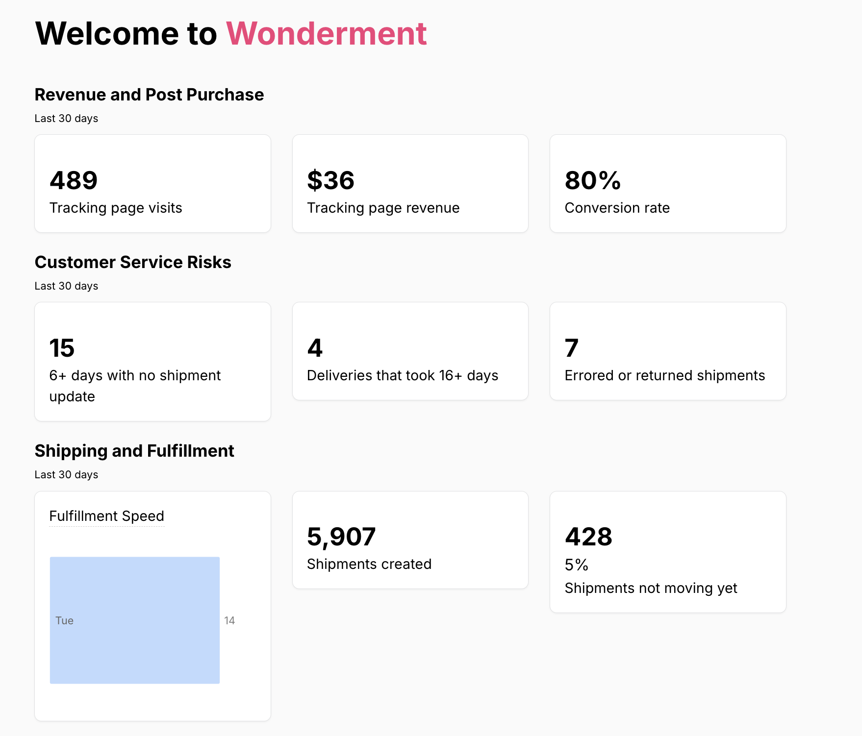
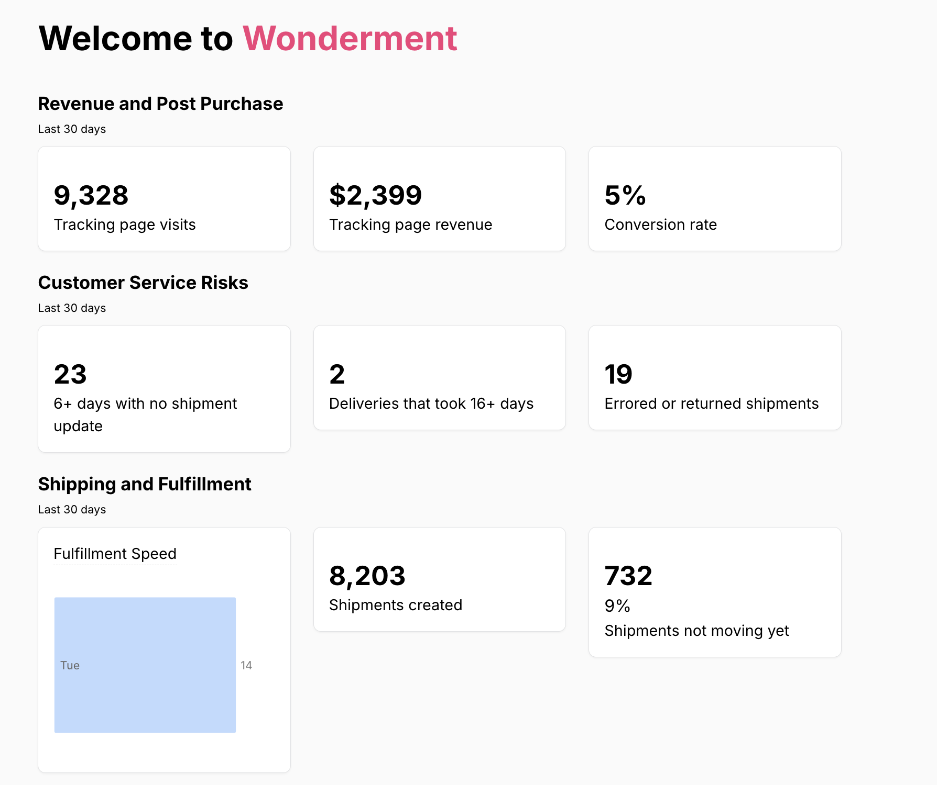
Wonderment Tracking Page

Slide 5
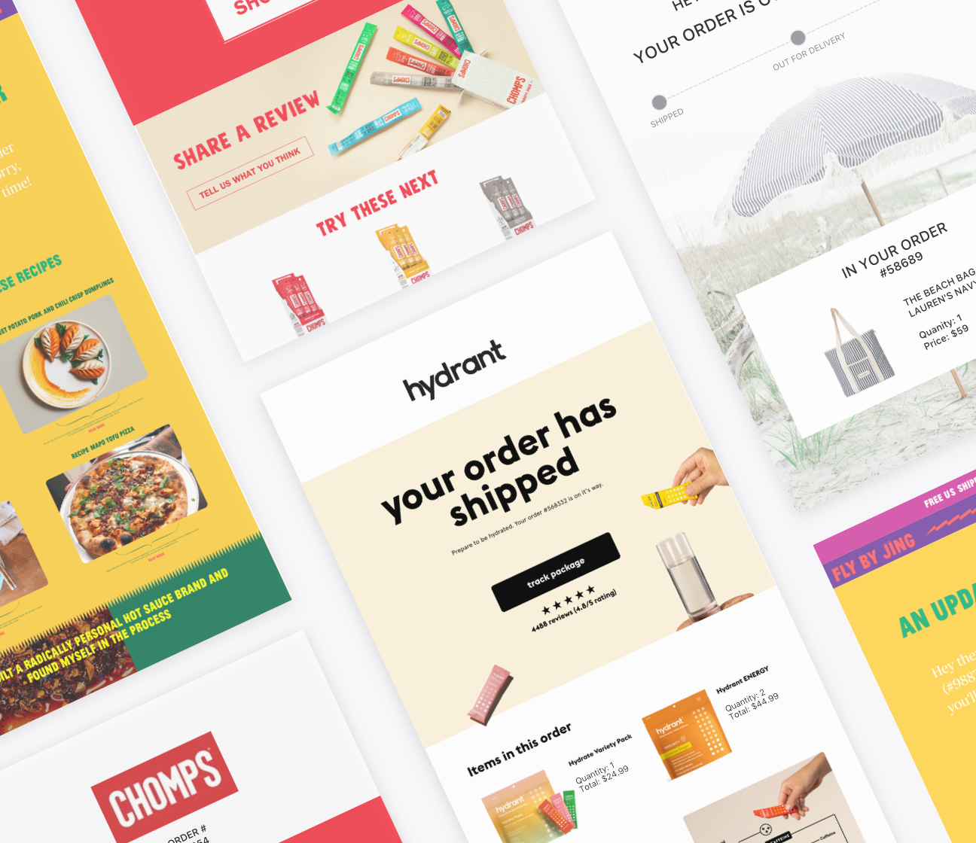
Wonderment Tracking Page
In The Last 30 Days |  | Benchmark
Tracking Page Views
Tracking Page Views to Orders |  | 1.2x - 4x
Tracking Page Revenue
Tracking Page Conversion Rate |  | 0.7-1%

Slide 6
Tracking Page Views
If Wonderment Tracking Page views are below 1.2x:
Check shipping speeds (Reports -> Delivery Performance). If the deliveries are 3 days or less from carrier picked up to delivery, that’s probably why.
If not, check:
Are all Wonderment-driven Klaviyo emails turned on?
Are the emails marked as transactional?
Are the UTM Parameters turned on?
Are the Klaviyo emails linking to the correct tracking page? (Should be {{ event.StorefrontTrackingURL }} as the link)
Is the tracking page rendering as expected?

Slide 7
Tracking Page Revenue
If Wonderment Tracking Page revenue is below 0.7%
If the store sells big-ticket, once-in-a-decade products (mattresses, couches):
Do they sell accessories? Are they on the tracking page?
If they do not sell accessories, focus on customer education/reduction of support tickets
Otherwise:
Check products on tracking page – are they optimized for repeat purchases?
Use Google Analytics to identify the items most often bought after visiting the tracking page and highlight those products on the tracking page.
If the customer has a subscription component, is the subscription information on the tracking page?
Turn off pop ups on tracking page

Slide 8
Other Tracking Audit Questions
Is there an email and/or SMS marketing embedded form on the tracking page?
Klaviyo
Attentive
Postscript
Have the FAQs been updated recently?
Recommend updating every quarter with the most commonly asked questions customers have after purchase through 2 weeks post-delivery

Slide 9
Optimizing Your Customer Communication Channels

Slide 10
Wonderment Customer Communications
Since Launch | Customer | Benchmark
Open Rates | 42.03% | 60-80%
Click-Through Rates | 7.51% | 10-20%
Revenue | $684
Since Launch | Customer | Benchmark
Open Rates | 82.63% | 60-80%
Click-Through Rates | 23.26% | 10-20%
Revenue | $20,684

Slide 11
Wonderment Data-Driven Customer Comms
Since Launch | Customer | Benchmark
Email Open Rates |  | 60-80%
Email Click-Through Rates |  | 10-20%
Email Revenue
SMS Click-Through Rates |  | 50-75%
SMS Revenue
*5 Days Opened or Clicked Email

Slide 12
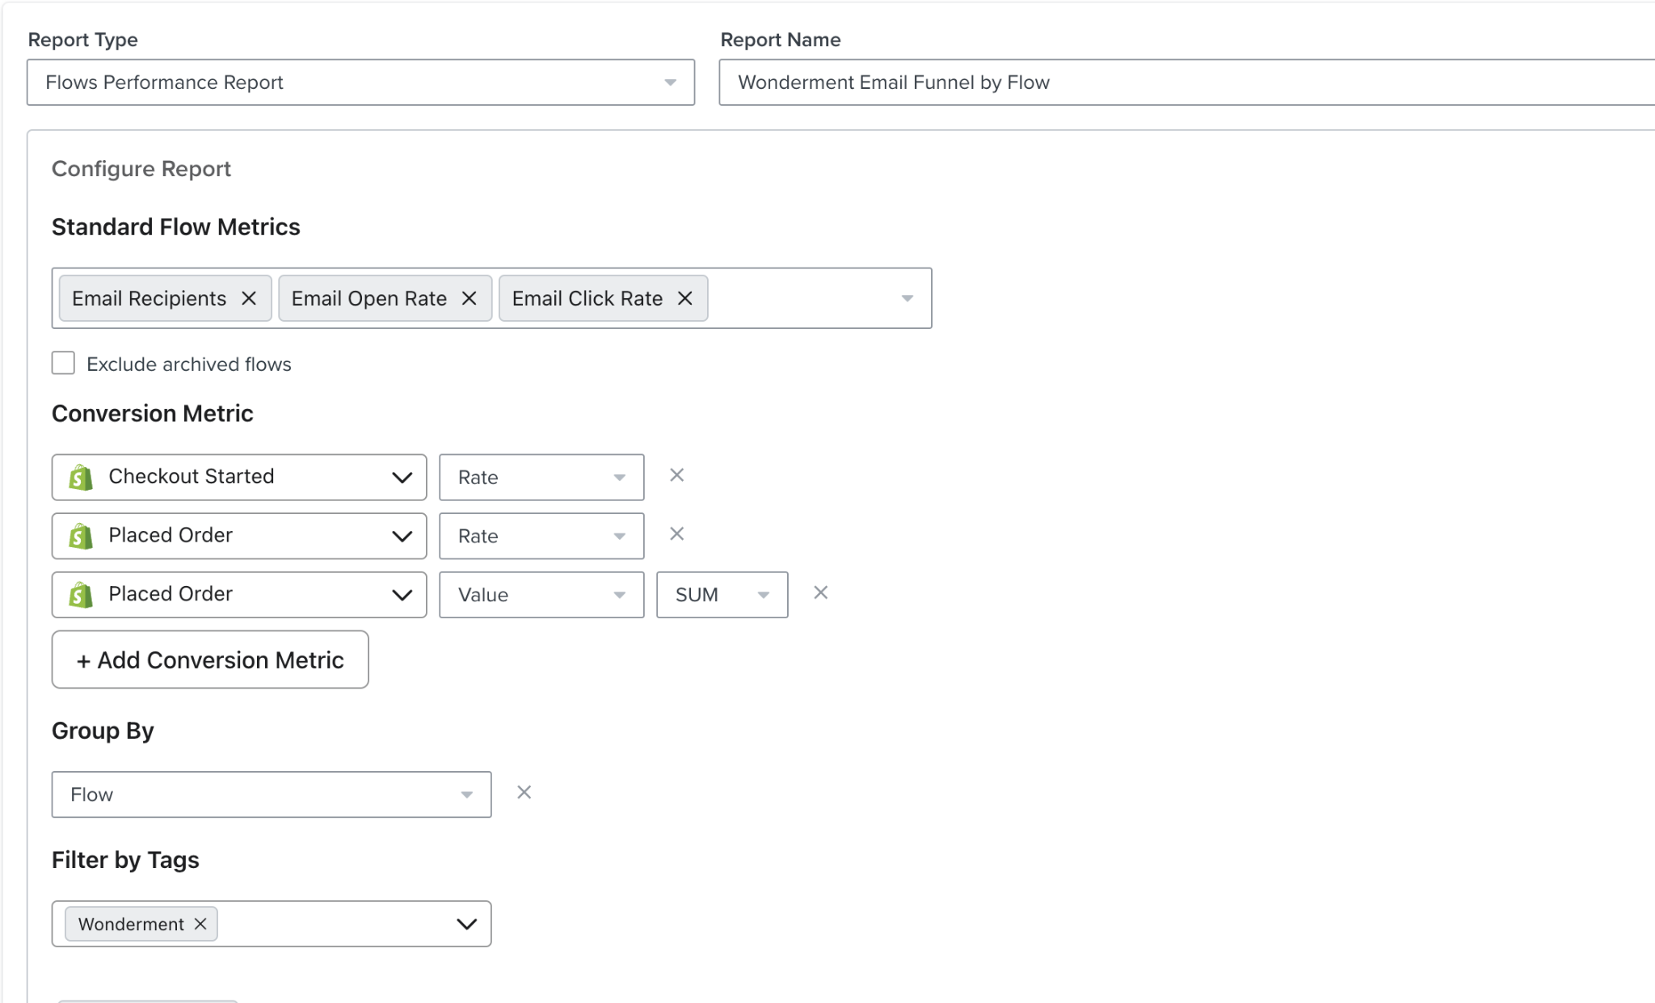
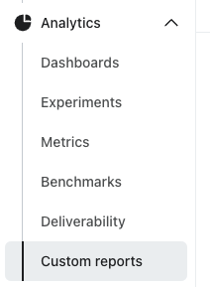
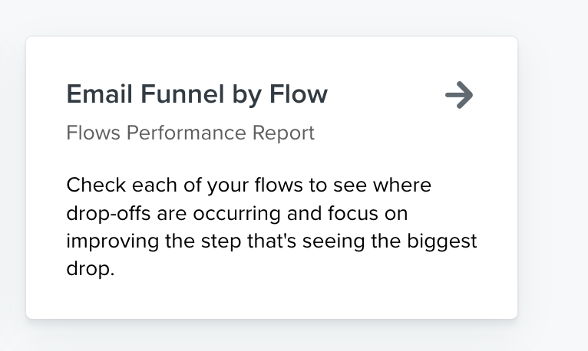
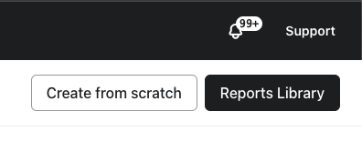
Pro Tip: Let Klaviyo do the math!
Go To Custom Reports
Click “Reports Library”
Select “Email Funnel by Flow”

Slide 13
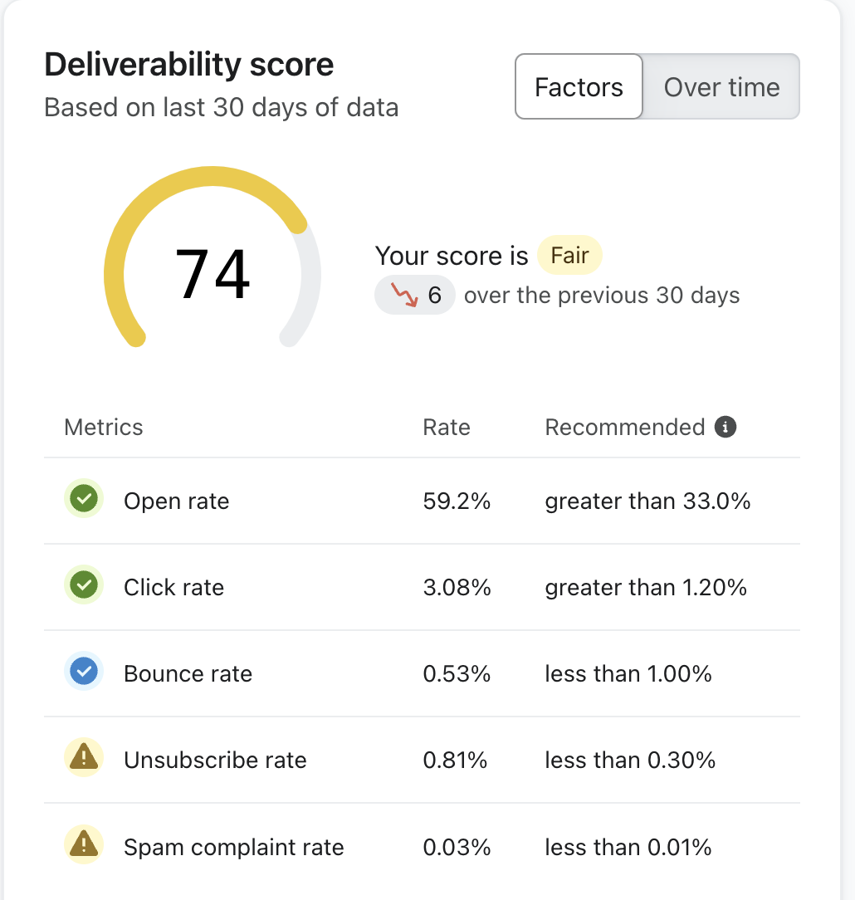
Increase Open Rates
Are the emails marked as transactional?
Check Deliverability report – if the score is “Good” or below, work on improving deliverability
A/B Test Subject Lines to Increase Open Rates
Cialdini’s Principles of Influence

Slide 14
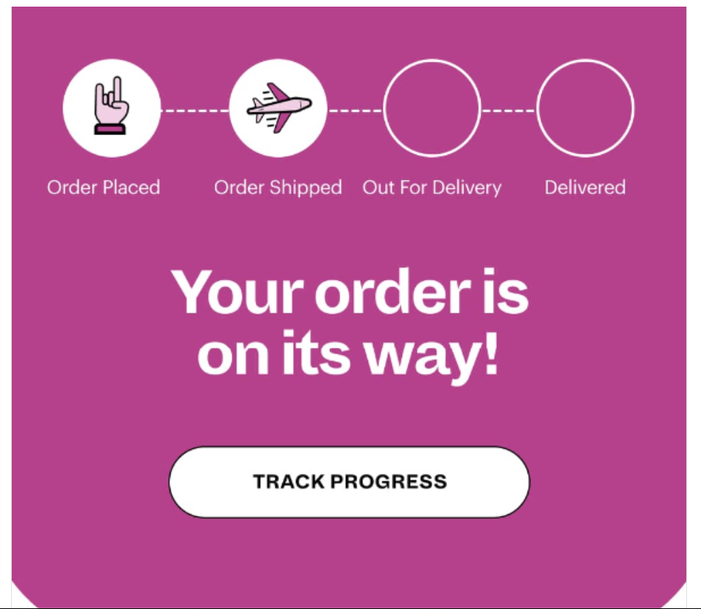
Increase Click Rates
Are the emails marked as transactional?
Check Deliverability report – if the score is “Good” or below, work on improving deliverability
Increase size and visibility of tracking buttons
Move tracking button closer to the top of the email

Slide 15
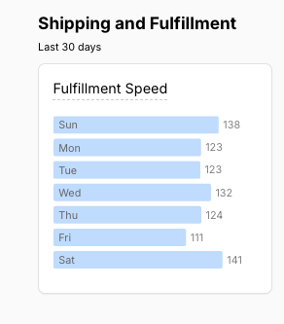
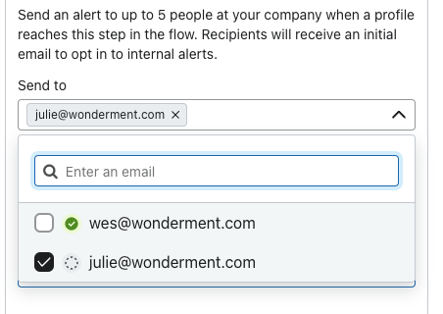
Other Klaviyo Audit Questions
Are all of the emails live?
Would they benefit from a delayed fulfillment email?
Would they benefit from a delayed carrier pickup email?
Are the customers using the Klaviyo internal notifications?

Slide 16
Integrations

Slide 17
Email / SMS
 | Using? | Integrated?
Klaviyo
Sendlane
Postscript
Attentive
Iterable
Recart
Yotpo

Slide 18
Help Desk
 | Using? | Integrated?
Gorgias
Zendesk
Other

Slide 19
Other Integrations
 | Using? | Integrated?
Corso
Loop Returns
Rebuy
Fairing
Kno

Slide 20
Recommendations

Slide 21
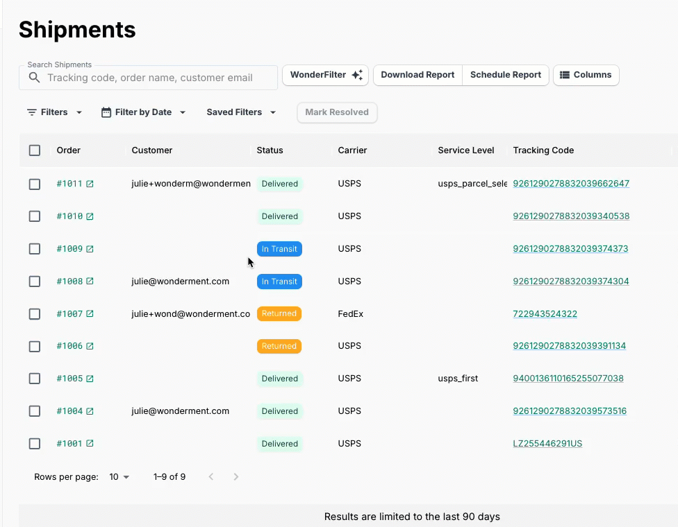
Additional Optimization Recommendations
Add Wonderment Delivery Feedback surveys
Wonderment Delivery Promise
Set up scheduled reports for key metrics
Commonly used reports:
Packages stuck in transit
Packages stalled pre-transit
Packages exceeding carrier SLAs
Wonderfilter
Prep for BFCM!

Slide 22
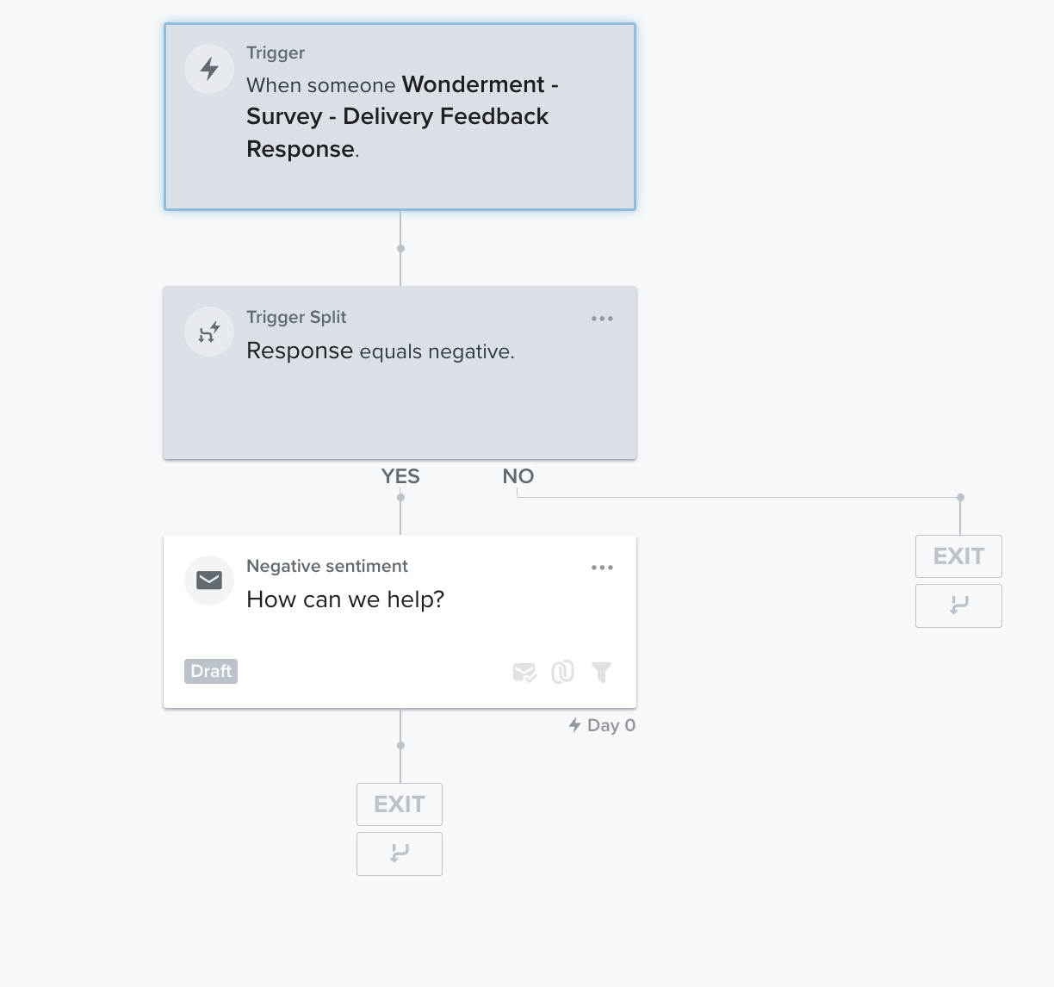
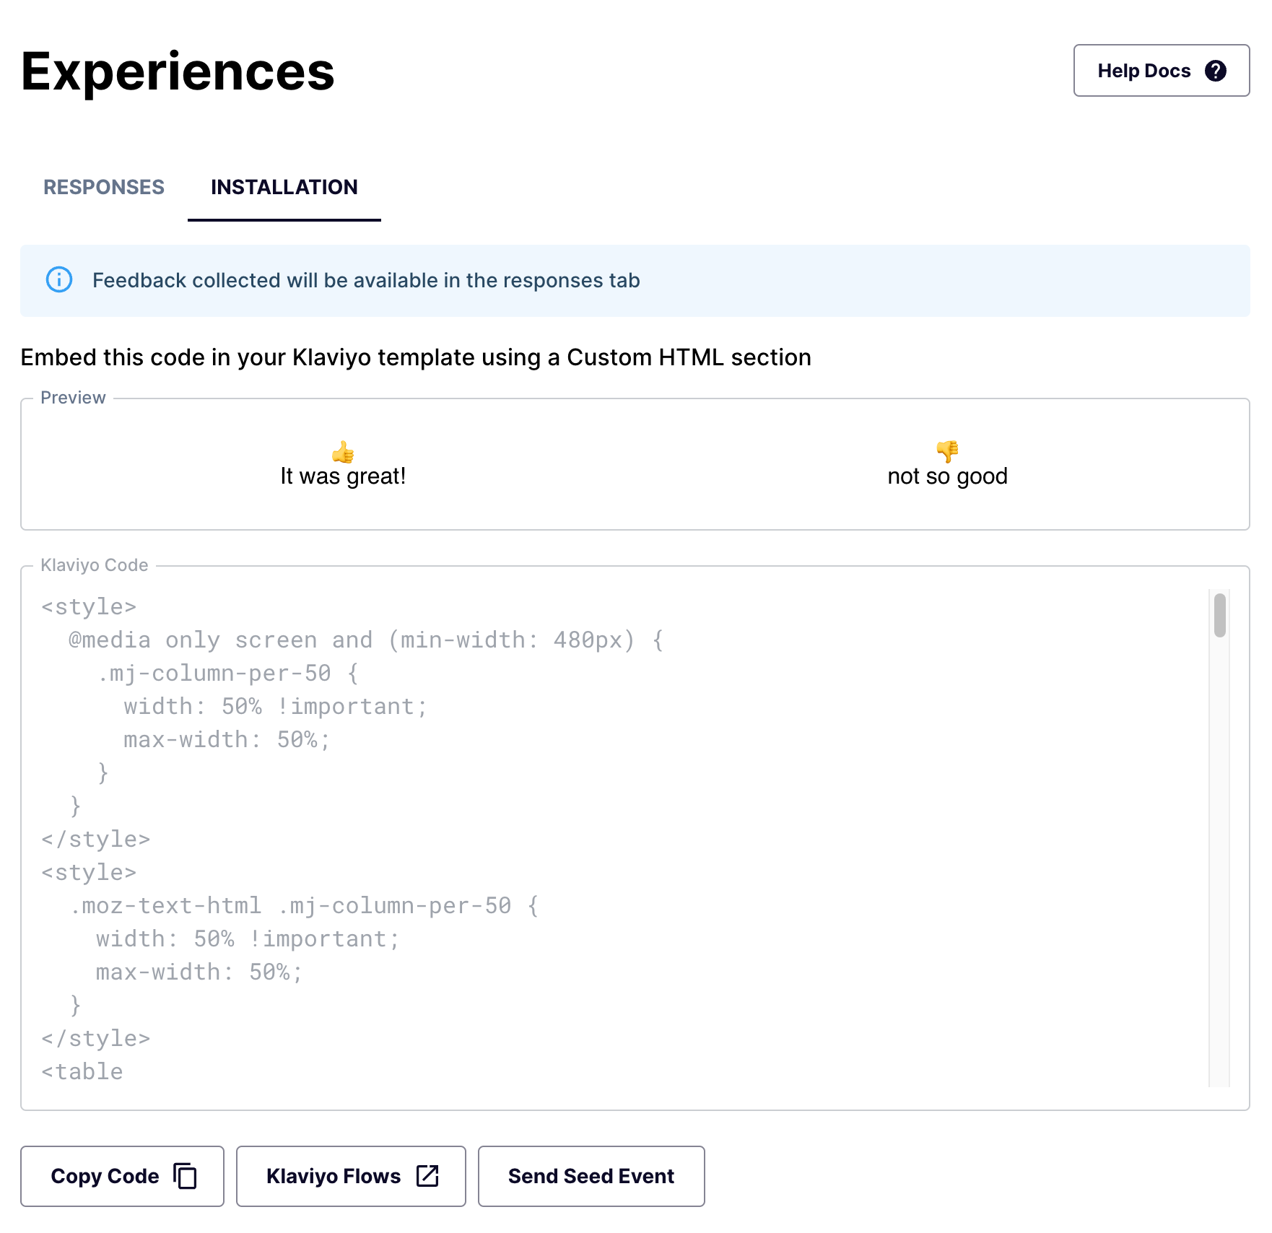
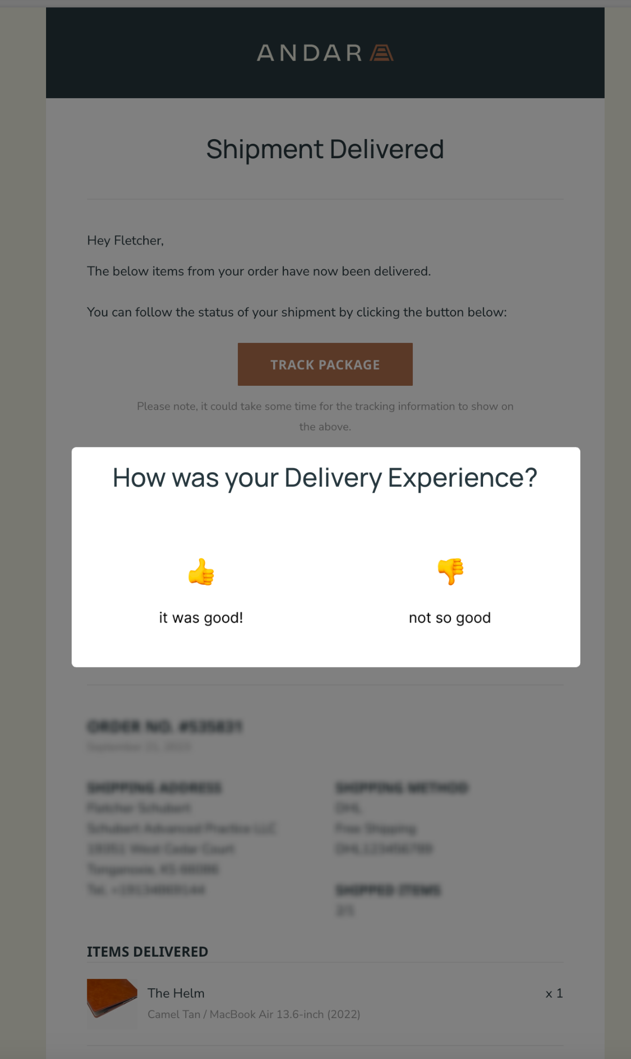
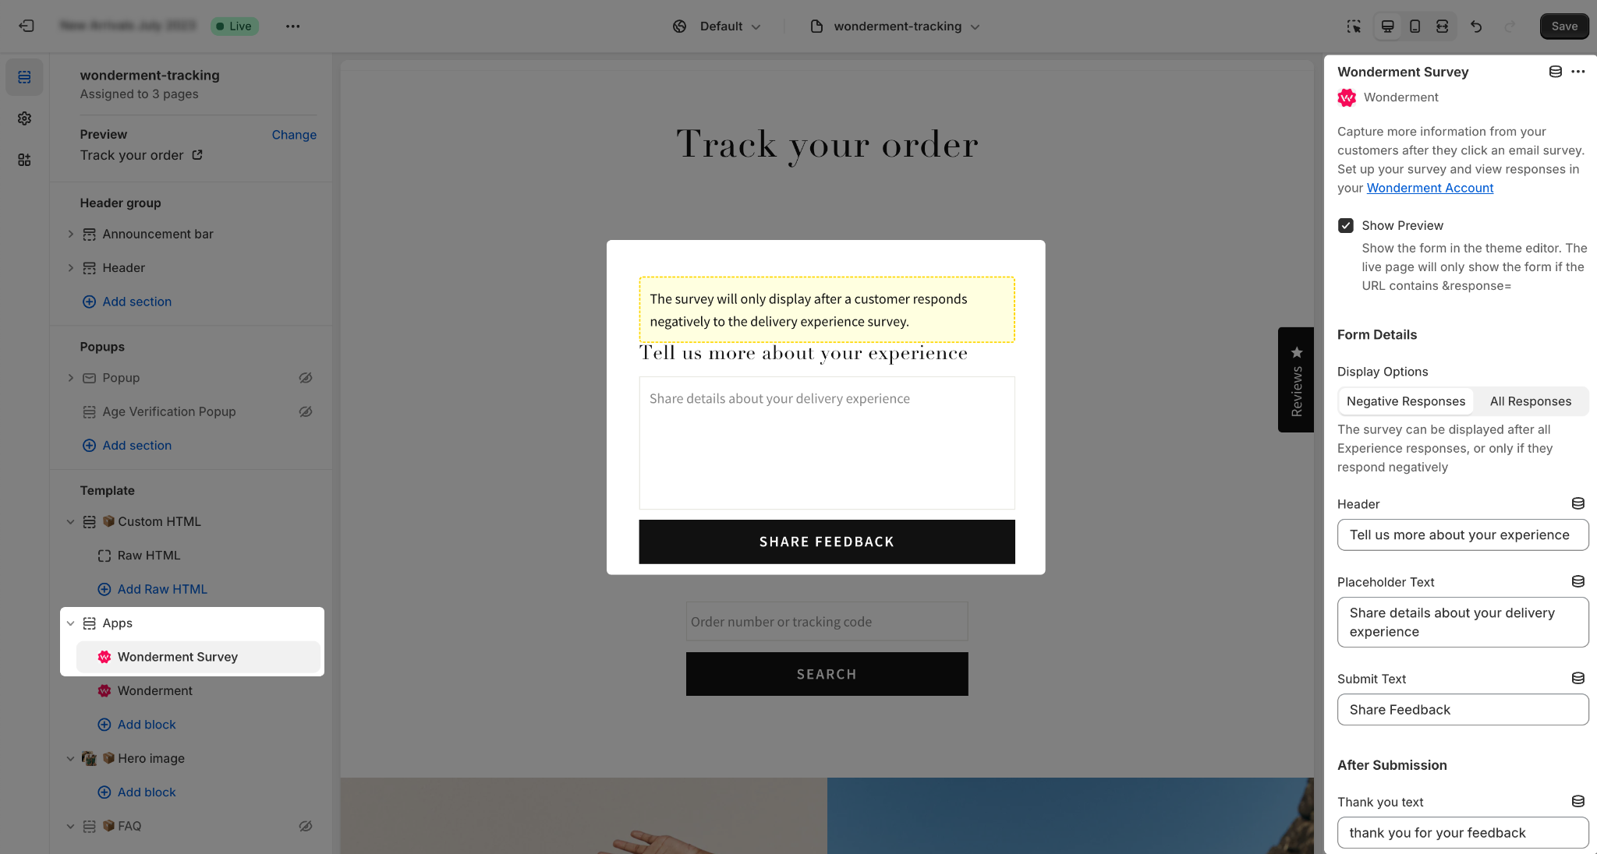
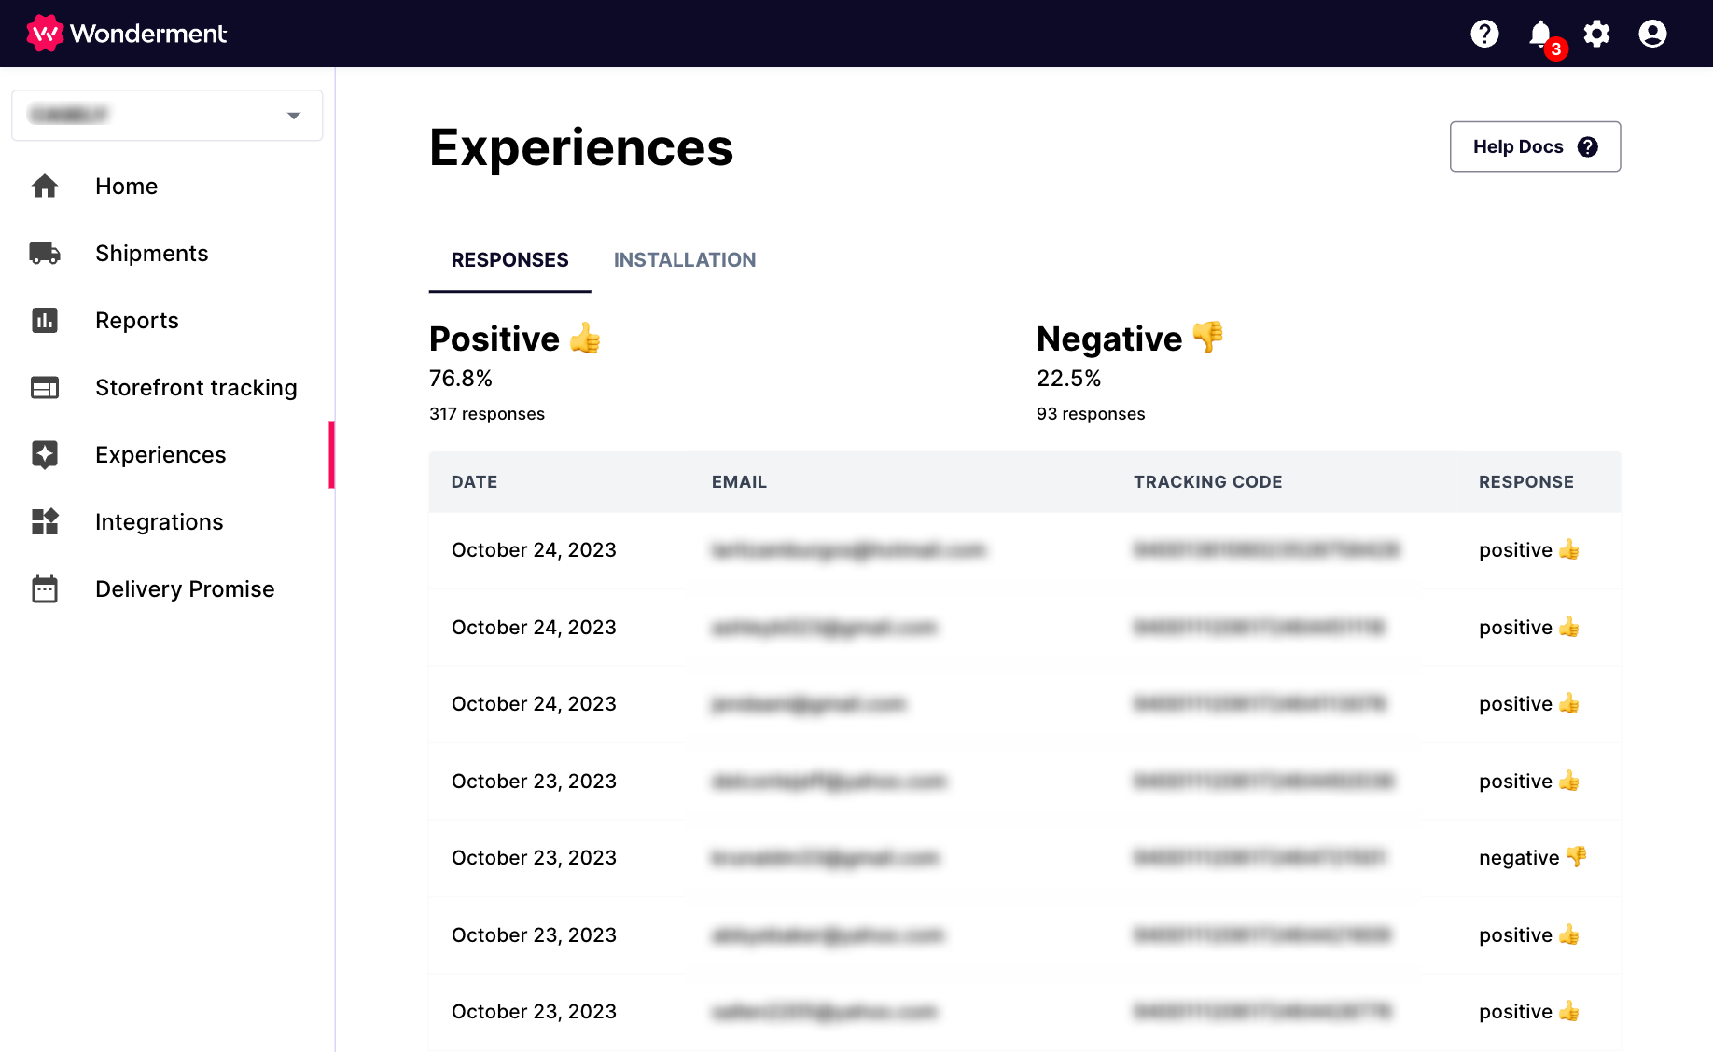
Delivery Experience Surveys

Slide 23
BFCM Prep

Slide 24
September BFCM Prep
Ensure you have
All 6 shipping emails set up
Transactional SMS (Klaviyo, Attentive, PostScript)
Add SMS / Email marketing capture to Storefront Tracking pages
PostScript
Attentive
Klaviyo
Set up Reporting for Q4
Service Level + Time in Transit - monitor for packages in transit longer than carrier SLA
Stalled Shipments
Returned / Damaged Packages
Packages not Picked Up in X days

Slide 25
October BFCM Prep
Audit all internal notifications to ensure all relevant information is included - confirm with CX team if any additional information would be helpful
Add banner or verbiage to transactional emails and tracking page FAQs about holiday shipping timelines
Decide on LTOs and Bundles that should be added to the tracking page for upsell/cross-sell opportunities
Deploy Delivery Experience Surveys

Slide 26
First Week of November
Change verbiage above products on tracking page to “Great Gift Ideas”
Add LTOs and Bundles to the tracking page for upsell/cross-sell opportunities

Slide 27
BF Week!
Add banner to tracking page about last shipping dates for holidays
Ensure relevant sales & promotions are shown on tracking page
Add “Great Gift” ideas banner to transactional emails, linking to gift guide collection on store

Slide 28
Early December
Change verbiage above product block to “Last Minute Gift Ideas”
Add gift cards and other fast-shipping options to the tracking page
Add “last day for holiday shipping” dates to the tracking page
Use Wonderfilter to set up a report if the ETA exceeds the holiday the gift is likely for.

Slide 29
Post-Holiday
(late December/January)
Revert verbiage above product block to prior text (usually “You May Also Like”)
Remove holiday shipping timeline information from transactional messaging and tracking page
Change products on tracking page to products most likely to be purchased by returning customers

Slide 30
Questions?

