Slide 1
Understanding GDST Capability
John Heggelund
02/24/2026

Slide 2

Presenter
John Heggelund
Software engineer specialized in traceability
Developing traceability software for 5+ years
Develop and maintain the Open Traceability SDK and Traceability Driver
Based out of Houston, Texas, United States

Slide 3



Outline
Technical definition of GDST Capability
Journey toward Capability
Breakdown components of GDST capable service
Examples of GDST queries and query patterns
Analysis of GDST Capability Test
Tools available to assist with development
Discussion with Solution Providers

Slide 4

Technical Definition of GDST Capability
GDST Capable Webservice
Data Standards
Web API that respects the GDST Open API specification
Adheres to EPCIS JSON schemas and GDST event types

Slide 5




Journey
01
02
03
04
Register
Map & Verify
Build
Test
Register for the capability test
Map database tables to CTEs and KDEs
Verify with the “check” tool or a JSON Schema Validator
Automate the mapping and deploy as a web API
Take the test
Analyse the results
Update your solution
Repeat until you pass

Slide 6
Questions
Do I have to use a specific language or framework for my solution?
No. As long your web API returns the expected results with complete CTEs and KDEs, you are free to use whatever technology stack best fits your use case.
Do I need to implemented EPCIS 2.0 completely to be GDST capable?
No. You are only required to implement the endpoints and functionality outlined in the GDST standard and technical implementation guide. You do not need to implement a complete EPCIS Query Interface.
Do I have to share my data with everyone?
No. You are in control of who can query your data using API key-based authentication.

Slide 7
Terms
Identifier Types
Key Terms
GTIN → Product Type ID
EPC → Product ID
GLN → Location ID
PGLN → Trading party ID
Event: Records a change in a specific product at a specific place at a specific time.
Master data: Static, unchanging data that is referenced on events like a foreign key.
EPCIS: Electronic Product Code Information System, the foundation of the GDST standard.

Slide 8

GDST Capable Webservice
Digital Link Resolver
I give you an identifier, you tell me where to get more information
Events
I give you query parameters, you give me a filtered set of events
Master Data
I request a resource, you give me the resource
Notes:
Directory look up.
I recommend using the developer documentation to understand exactly which query parameters you are required to support
These concepts are not unique to GDST or EPCIS. We’re talking about directory look ups, query endpoints, and get by id web services.
All the hard work of what query parameters to use, how to format your endpoints, how to format your data is already done for you. Just follow the spec and the standard.

Slide 9
Digital Link
Resolves identifiers to URLs (Digital Links)
Master data link
Events link
Enables
Flexibility in implementation
Eliminates
Requiring GDST identifiers throughout your internal systems

Slide 10
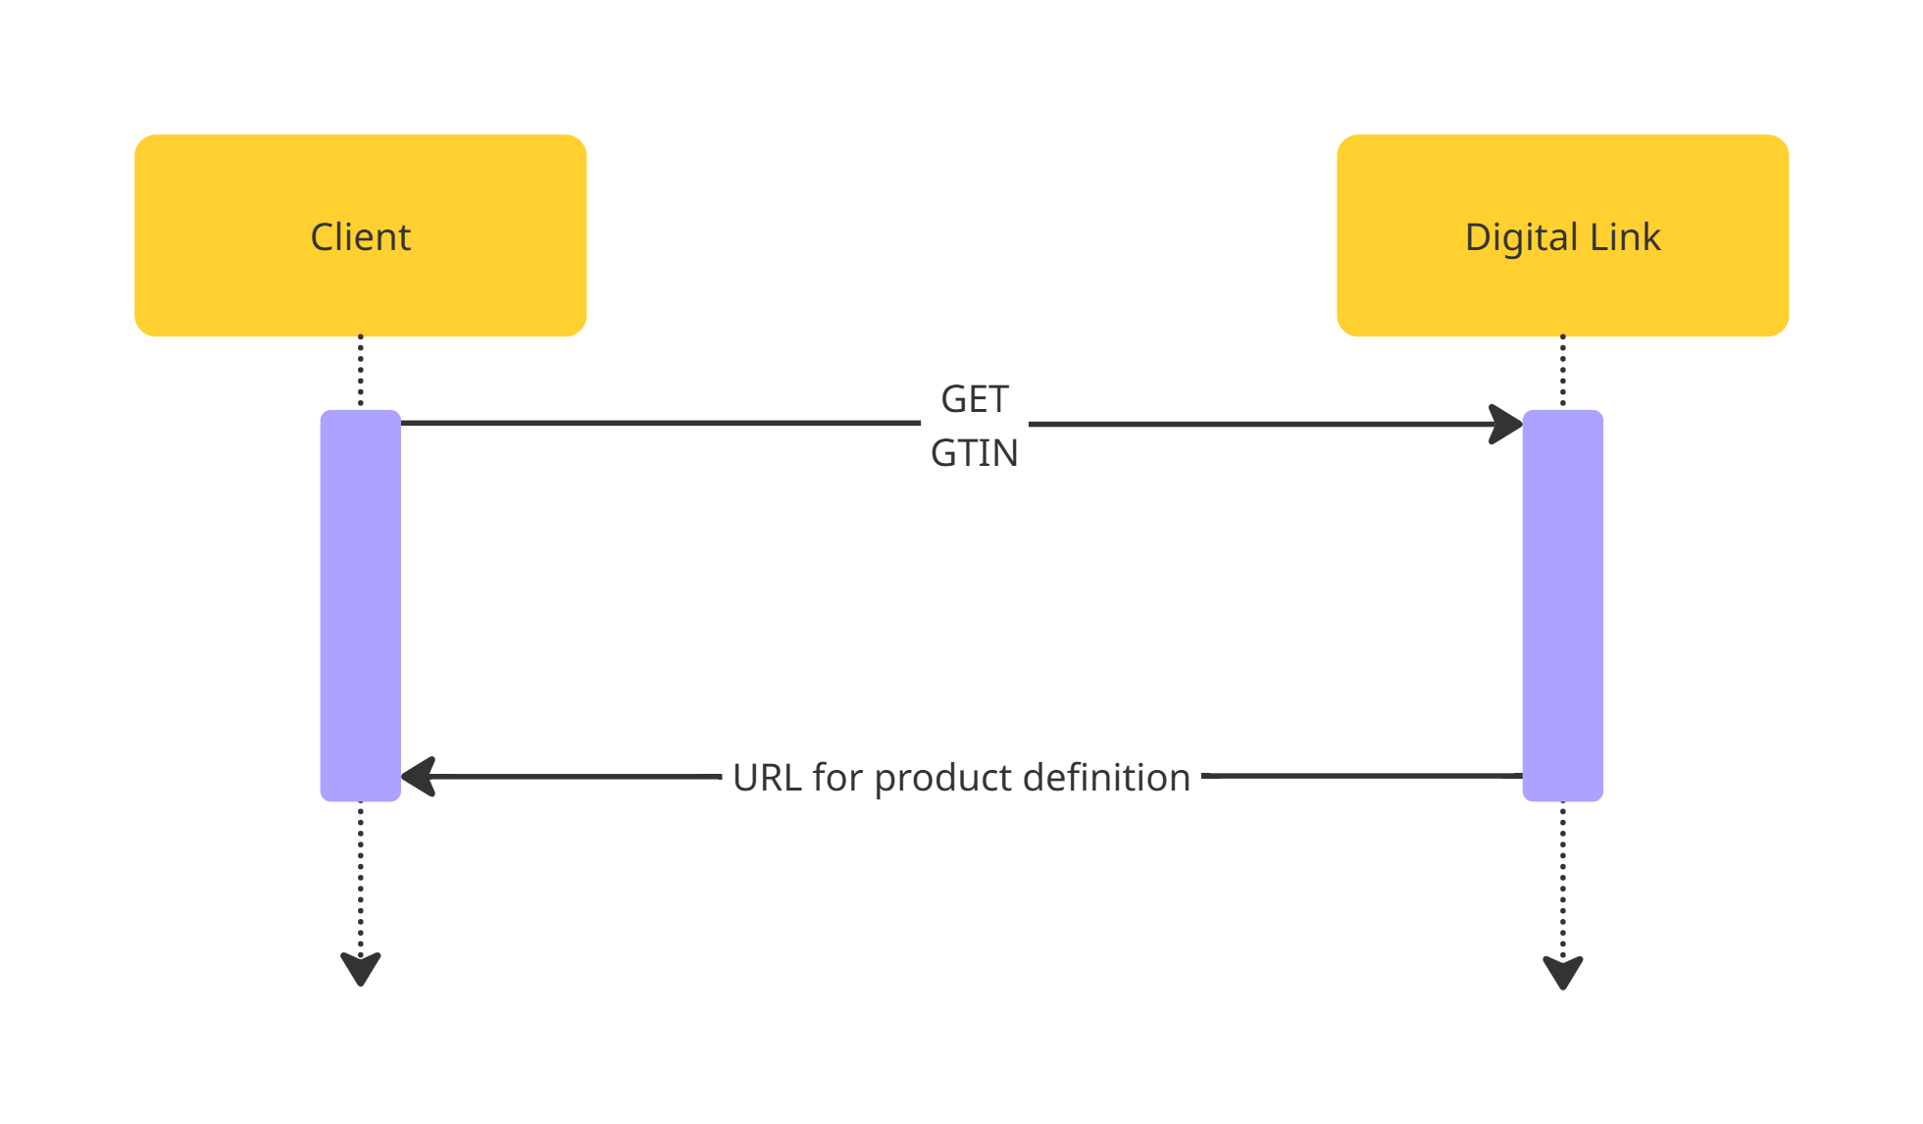
Digital Link (Simple Example)

Slide 11
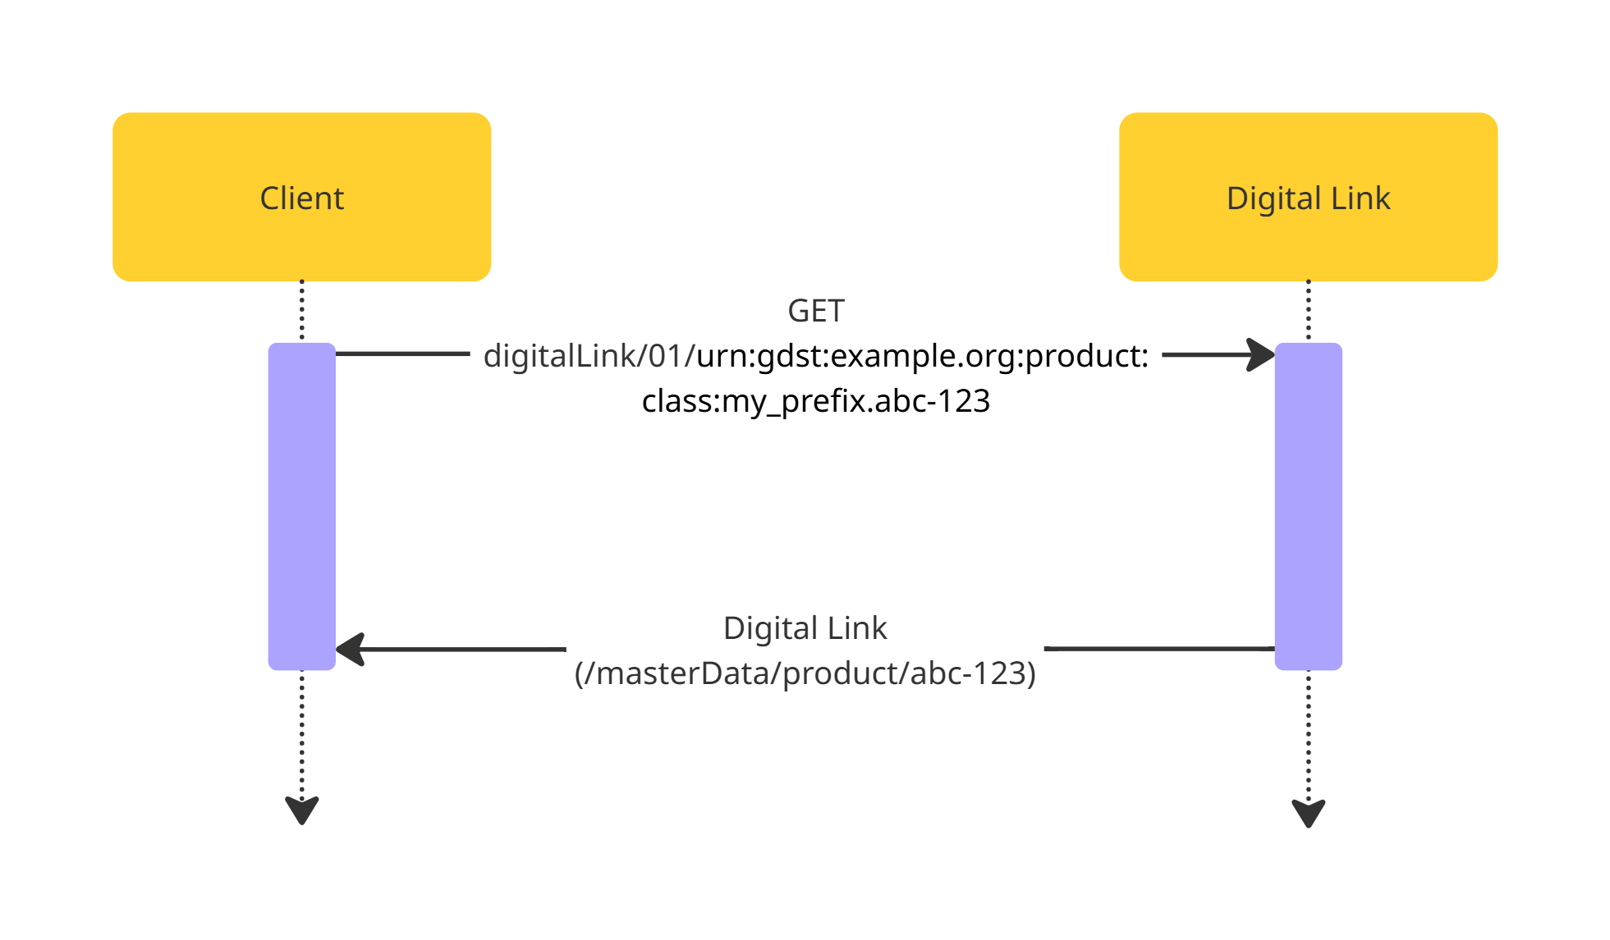
Digital Link (Expanded Example)

Slide 12
Events
Returns events matching the provided query parameters
MATCH_anyEPCClass: Return all events involving a specific lot.
LT_eventTime: Return all events less than a specific time.
GT_eventTime: Return all events greater than a specific time.
EQ_bizStep: Return all events with the specified business step, such as packing, unpacking, shipping, or receiving
Landing Event: Records a wild-caught arriving at port or on land for the first time.
Aggregation Event: Records products being grouped together for logistical purposes. This process is always reversible, like stacking boxes on a pallet.
Commingling: Records products being mixed such that they cannot be re-separated. This is irreversible, like mixing different lots of fish into a larger container.
Transshipment: Records the transfer of products from one vessel to another at sea.

Slide 13
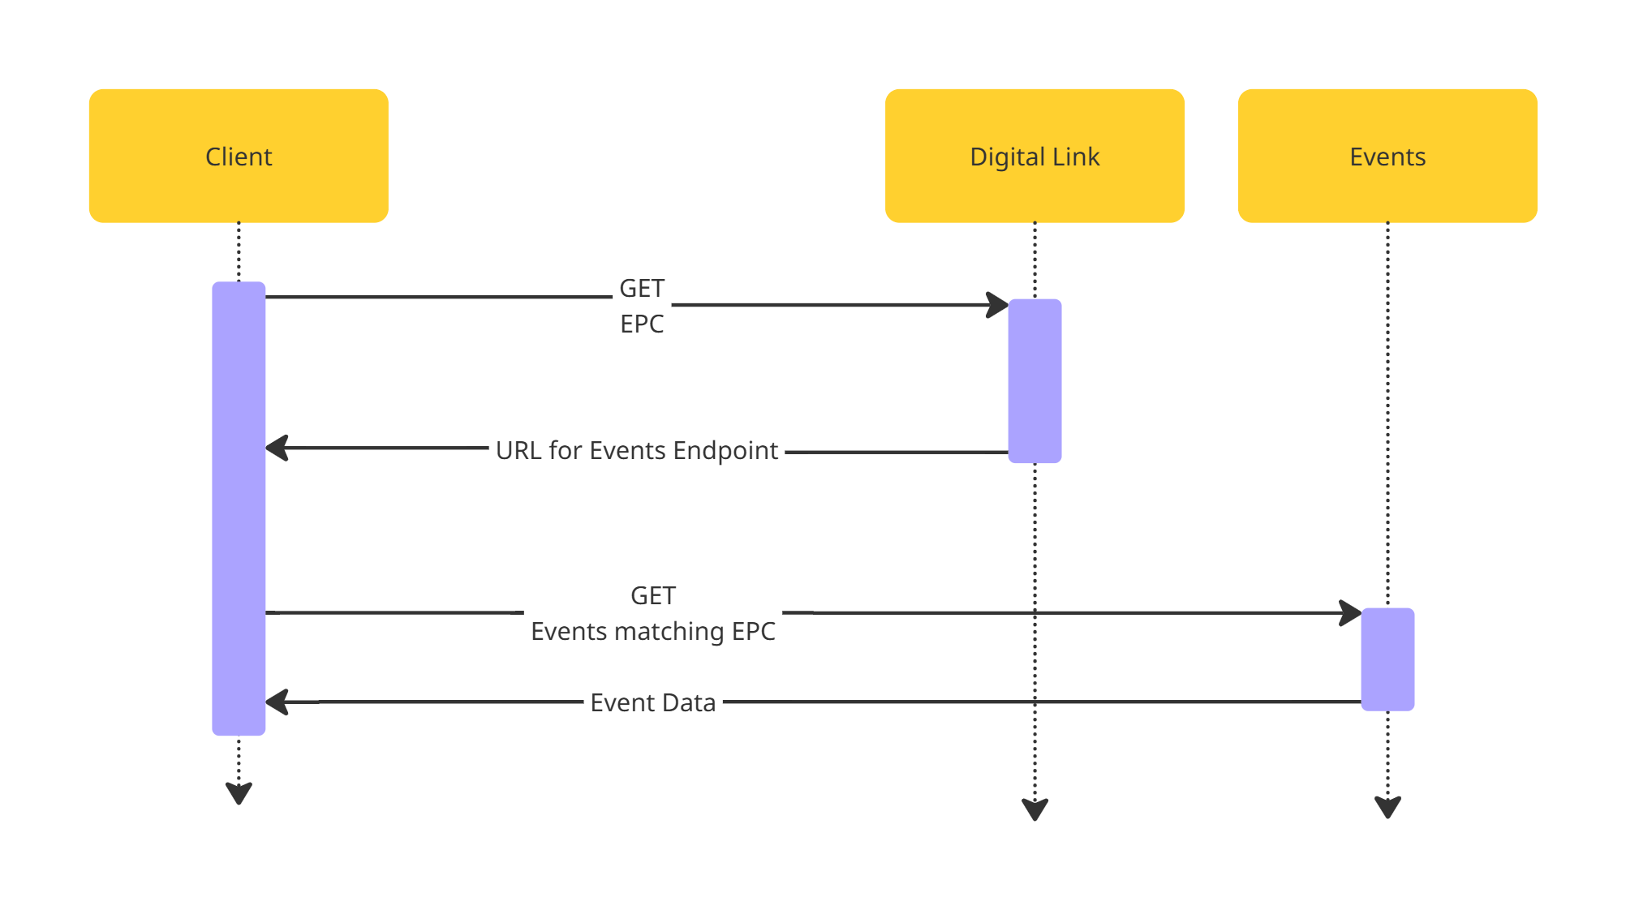
Events Example

Slide 14
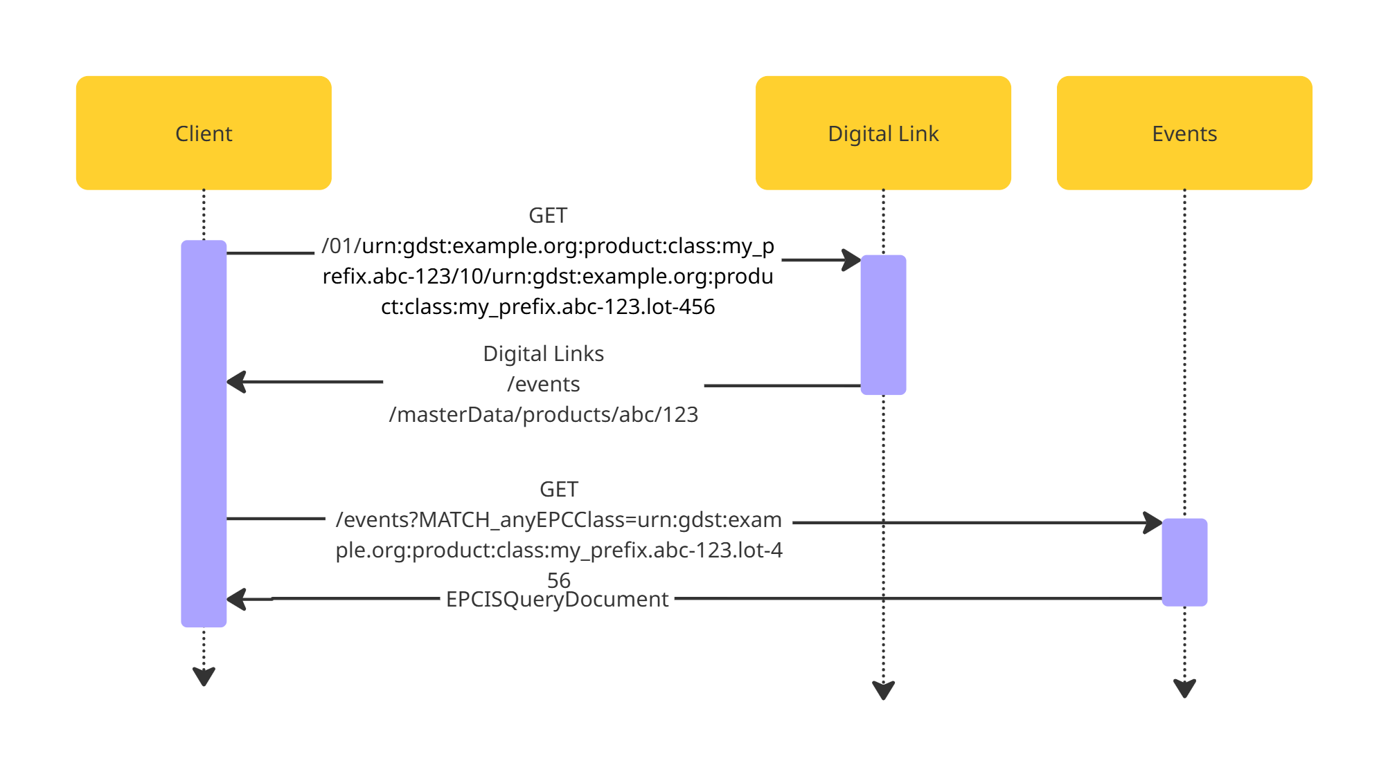
Events Example

Slide 15
Master data
Returns master data for requested resource
/masterData/products/abc-123
/masterData/locations/123
/masterData/tradingParties/456
Product Types
Locations
Trading Parties

Slide 16
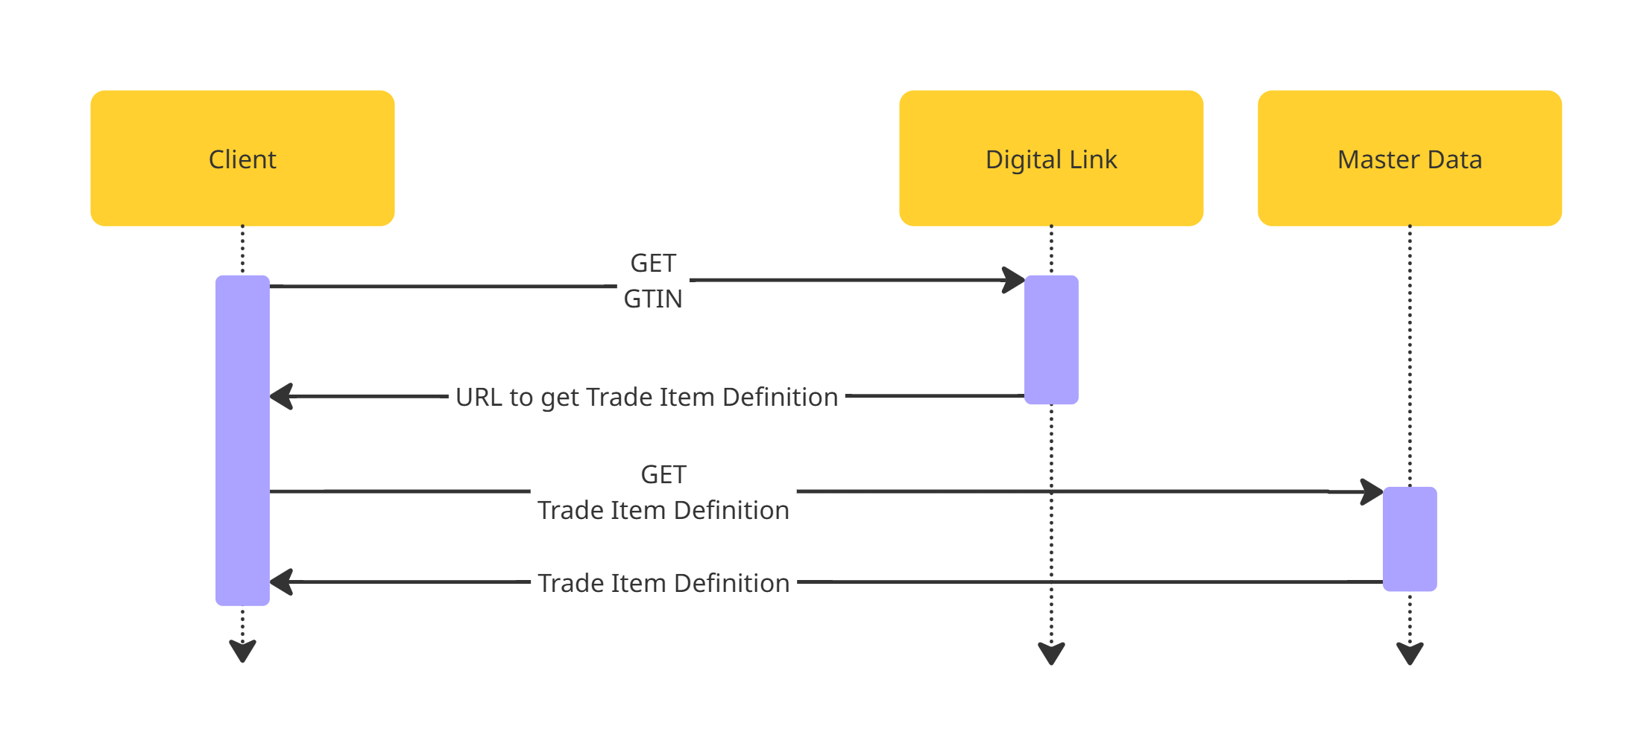
Master Data (Simple Example)

Slide 17
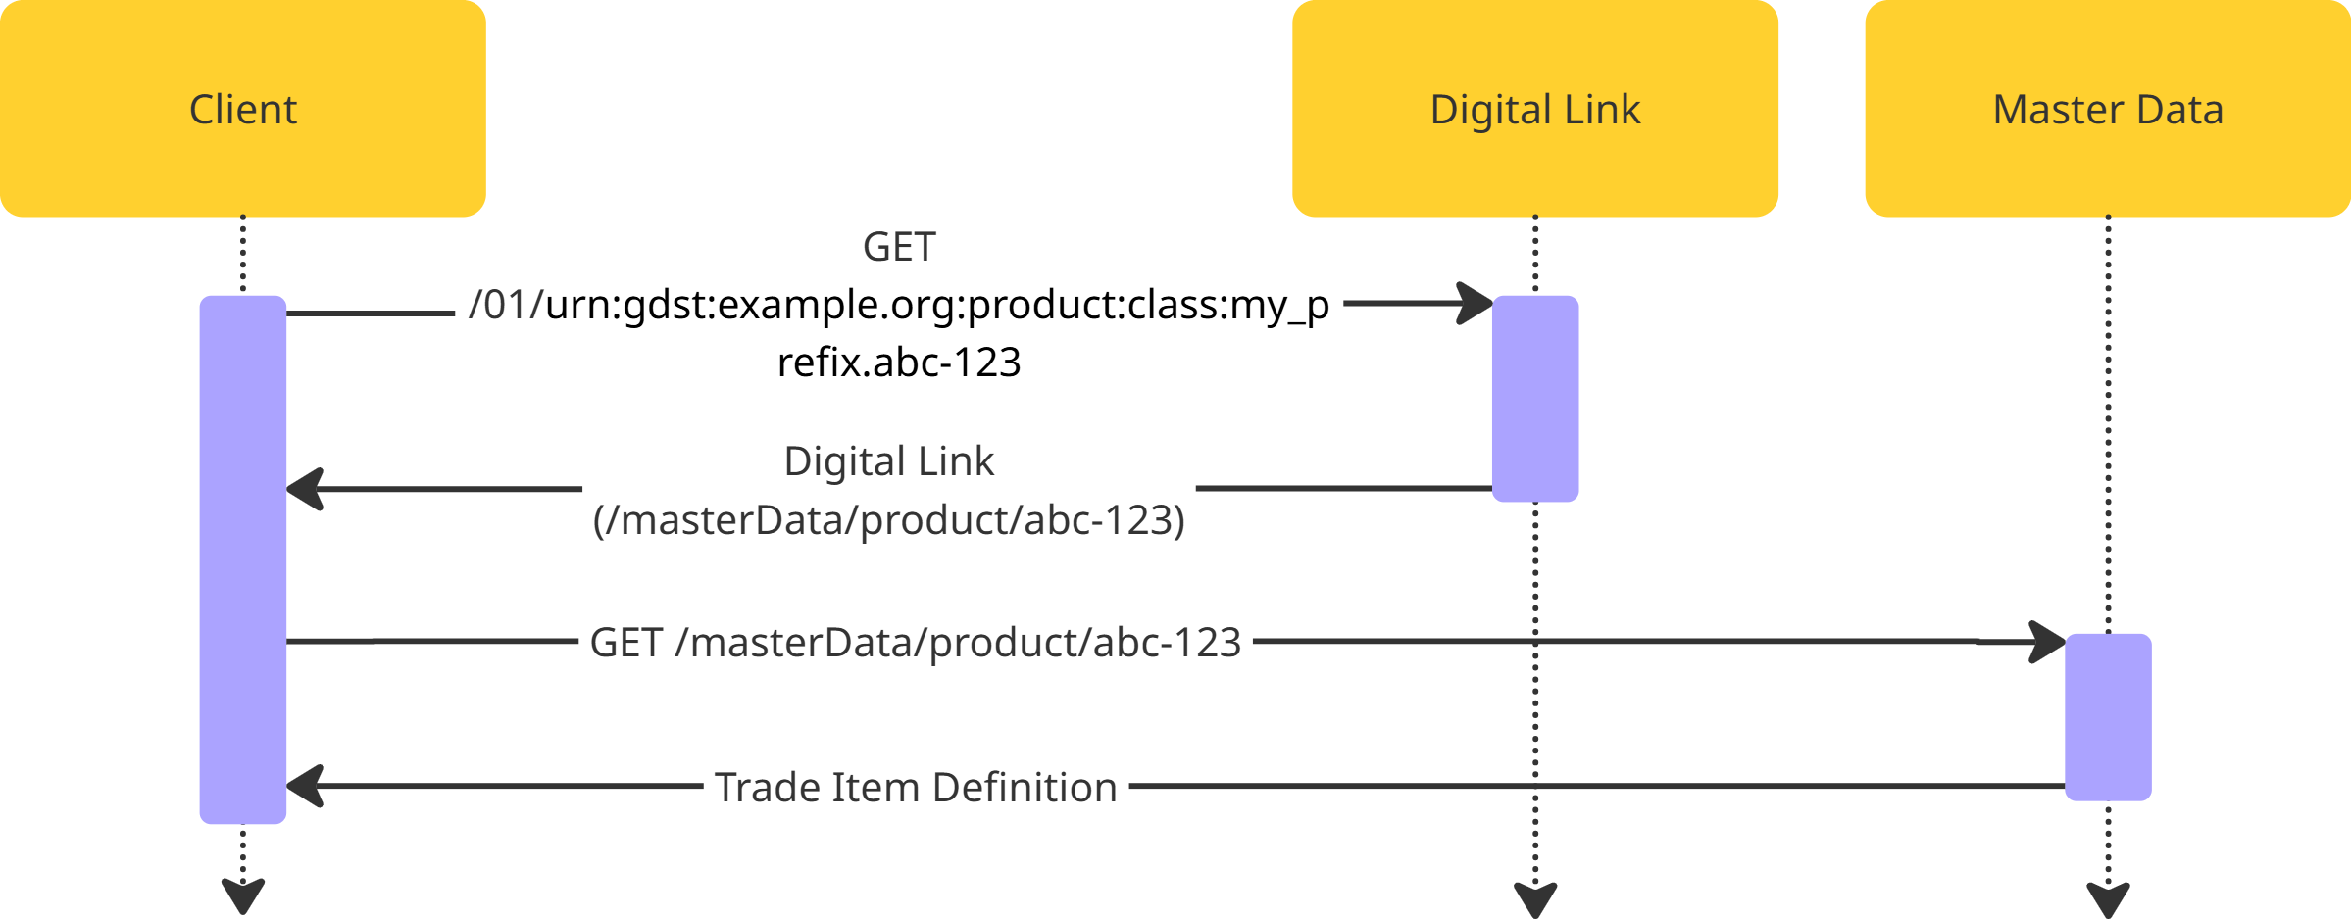
Master Data (Example)

Slide 18
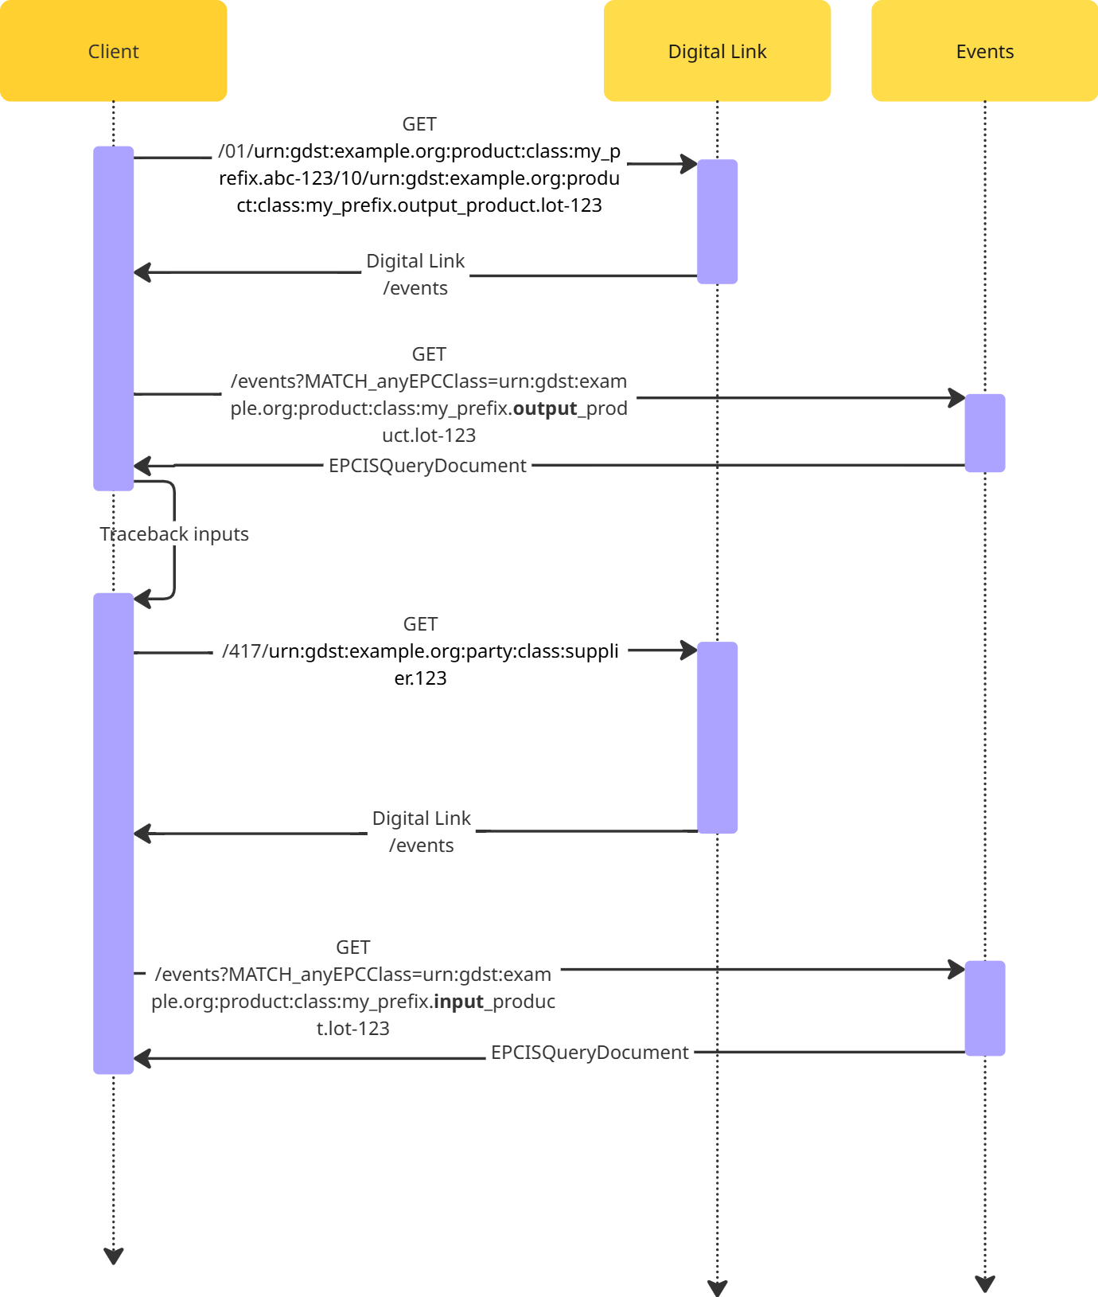
Traceback
Get all the data related to one or more products and their input or child products.
Involves multiple queries
Resolves digital links
Resolve master data
Query for events
Repeat recursively for each input and child product

Slide 19
Questions
Do I have to use GS1 issued GTINs, GLNs, PGLNs, etc…
No. The GDST standard includes an implementation of the private industry identifiers described in the EPCIS 2.0 Standard. This allows you to issue your own identifiers using a domain that you own to prevent collision with identifiers generated by other supply chain actors.
What are GDST Identifiers?
An implementation of the private industry identifiers described in the EPCIS 2.0 Standard with an official IANA registration. For more details, see the developer documentation.

Slide 20
GDST Capability Test
Performs a traceback on a product from your solution
Verifies all the required CTEs and KDEs are present
Outputs a report containing any errors
Two Formats
First Mile: Read only
Aquaculture
Wild-caught
Full Chain: Read and Write

Slide 21
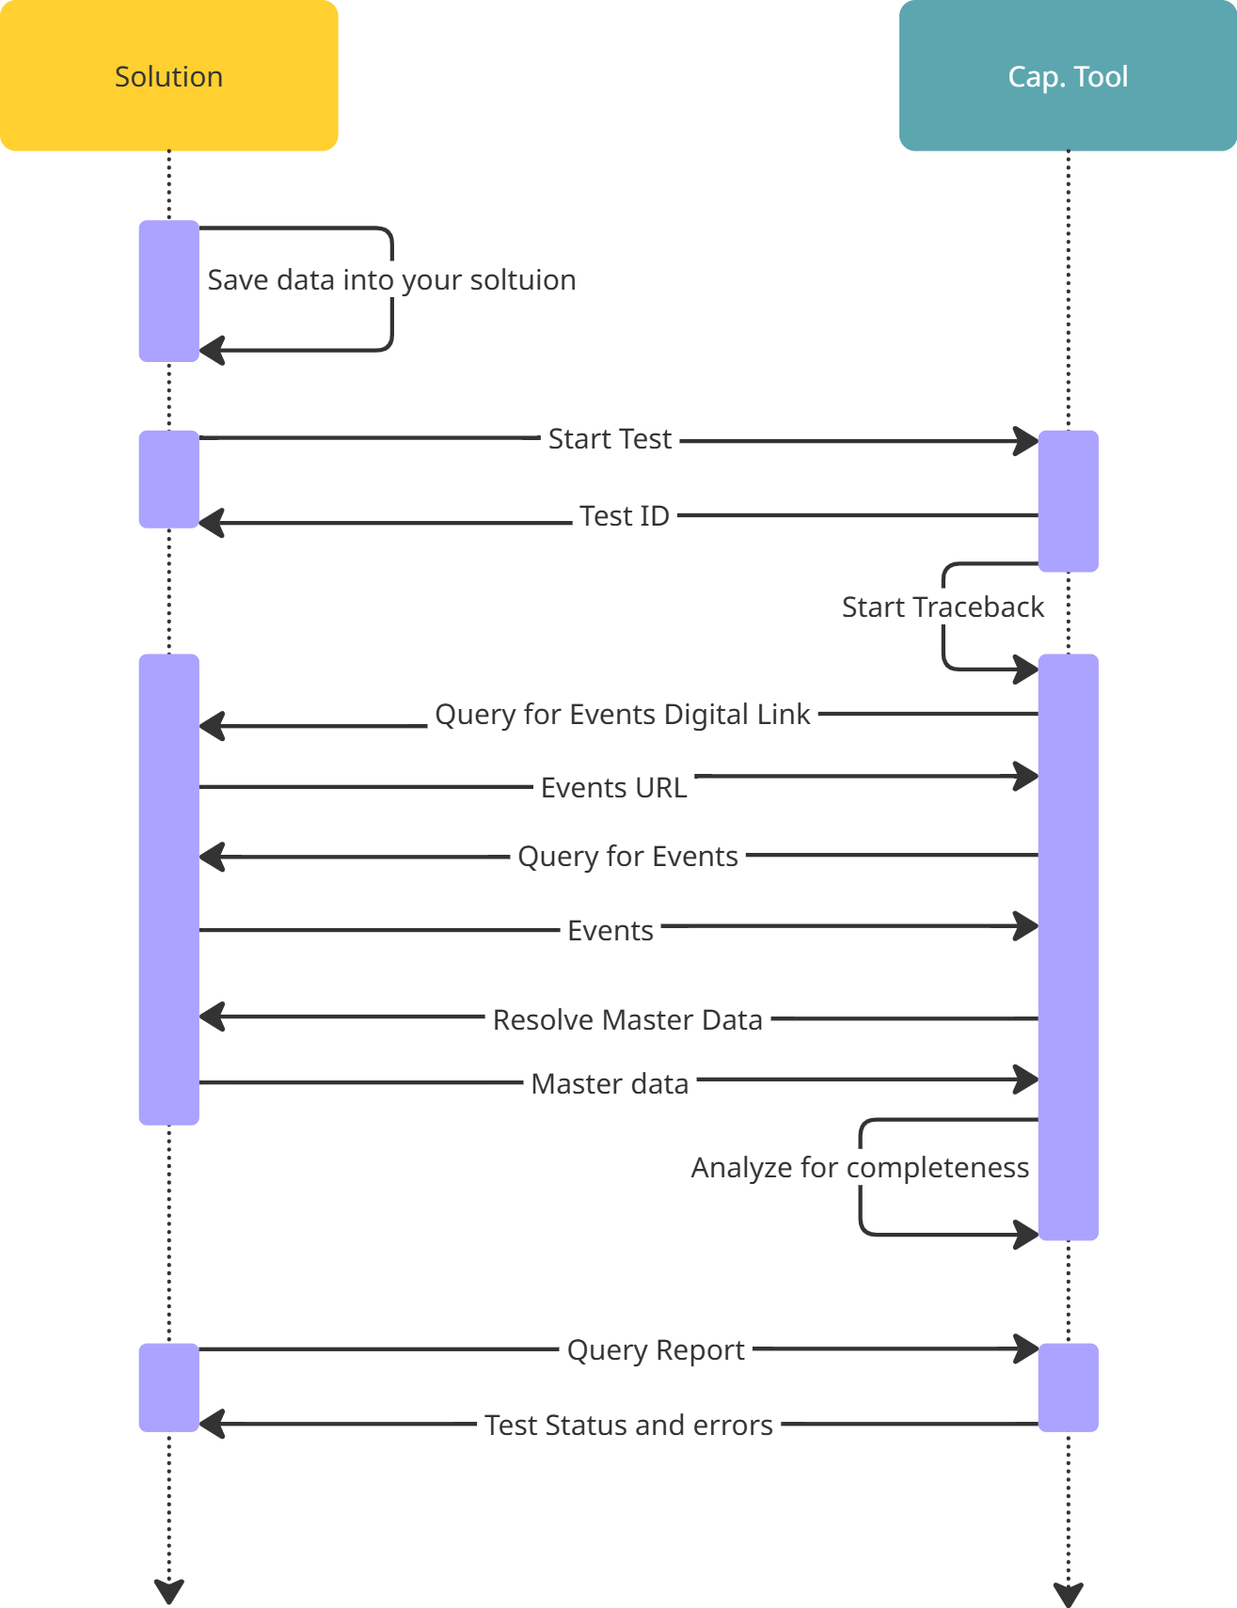
First Mile Test
Verifies that you can provide traceability data on demand in the correct format from the expected endpoints
Wild-caught
Fishing
Transshipment
Landing
Shipping
Aquaculture
Feed Mill
Hatching
Farm Harvest
Shipping
Receive

Slide 22
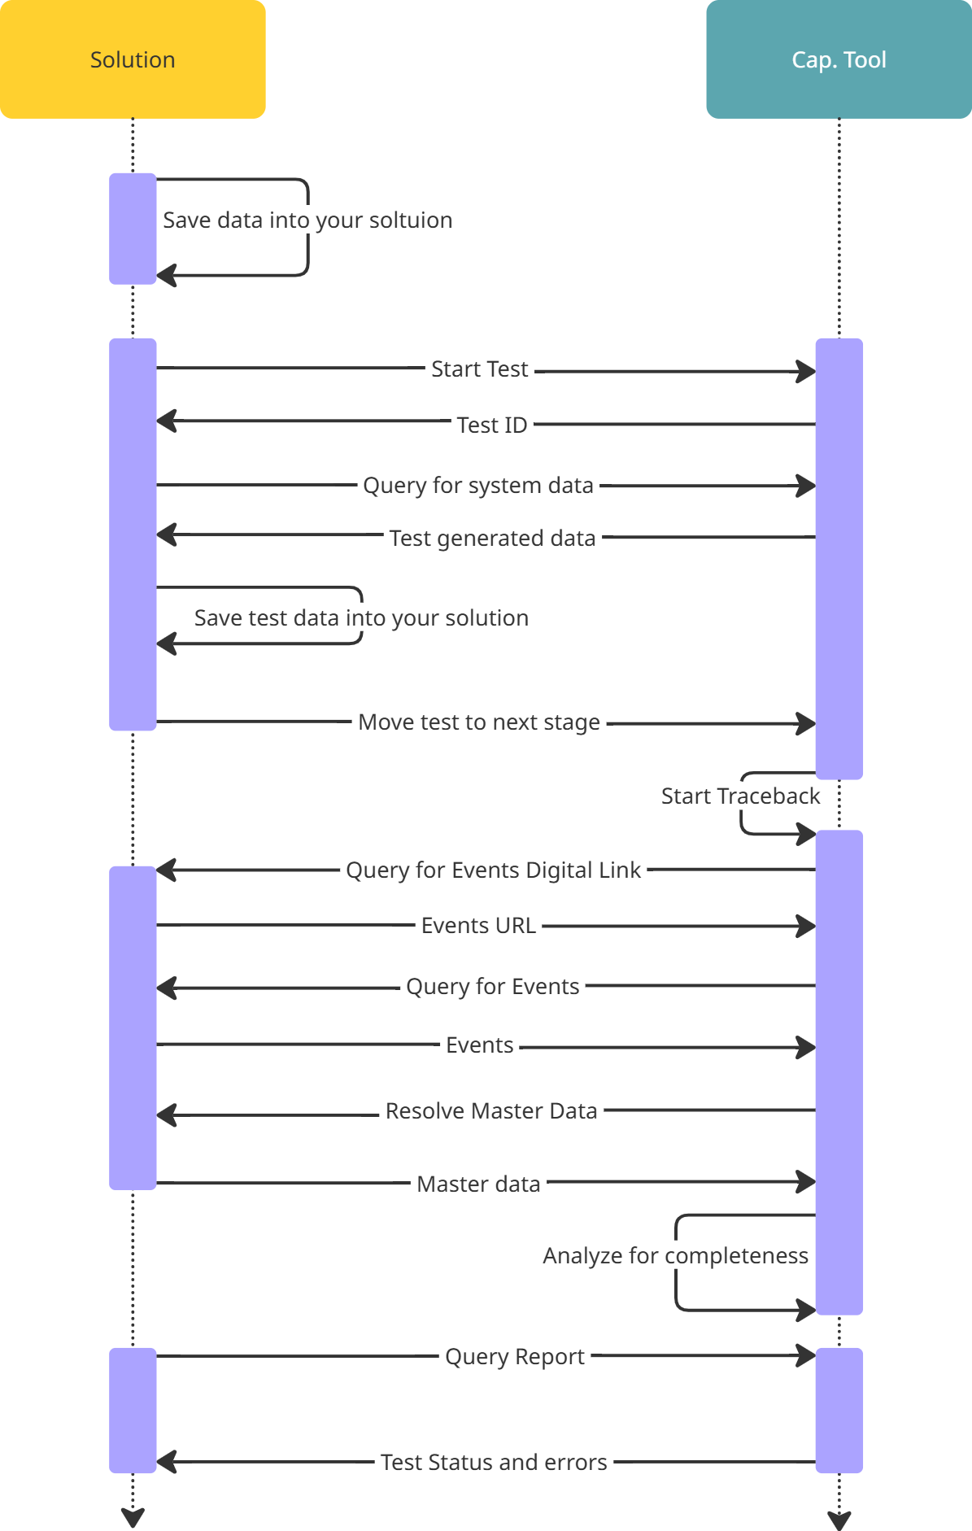
Full Chain Test
Verifies that you can save new data into your system and retrieve on it on demand without modification.
Includes first mile test requirements

Slide 23
Questions
What if I do not record a specific event type event in production?
The capability test verifies your system’s capability to store and retrieve complete traceability data. It does not test the completeness of your production data.
Can I take the test from development/staging environment?
Yes. The typical pattern is to pass the test in a development or staging environment before pushing to production. You can even incorporate the capability test into your CI/CD pipelines to ensure updates do not interrupt interoperability.
What happens after I pass the test?
Schedule a review of the results. Be prepared to query your solution for events and master data and to discuss technical details of your solution.

Slide 24




Tools
Quantum Leap
Traceability Driver
Diagnostics Tool
Open Traceability SDK
Digitize documents
Bootstrap GDST Capability
Debug interoperability in real-time
Low-level tooling

Slide 25
Quantum Leap
Digitize Paper Documents
Convert analog documents into digital traceability data
Analyze for GDST completeness
Export in JSON or Excel formats

Slide 26
Traceability Driver
Bootstrap GDST Capability
You provide the mapping, the Driver handles the rest
Open Source with MIT license
Standalone module deployed in your infrastructure so you stay in control
Link to code repository
Notes:
Invite Koltiva to talk about their

Slide 27
Diagnostics Tool
Debug Interoperability in Real-time
Integrate into your tools via the Open Traceability SDK
Deploy as a docker container within your own infrastructure
Neutral and 3rd party
Link to code repository
Assesses:
Data structure correctness
API functionality
Formatting errors
Protocol mismatches
Missing extension headers

Slide 28
Open Traceability SDK
Low Level Tooling
Everything you need to build a GDST capable solution from scratch
Open source with MIT license
Link to code repository
Provides:
Data models
Master data and event resolvers
Serializers for XML and JSON

Slide 29
Questions
How does Quantum Leap digitize documents?
Quantum Leap uses advanced OCR, layout analysis, text extraction, and Large Language Models to extract data from documents and transform it into a traceability format.
What infrastructure does the Traceability Driver require?
The Traceability Driver currently supports integrations with SQL databases. To deploy the driver, you will need to provision either a Mongo or SQL server to store the transformed traceability data.

Slide 30
Panel Discussion
Participants
Koltiva
For solution providers approaching the GDST Capability Test for the first time, where should they start to avoid rework later—what’s the first decision or assumption that matters most?
AP2HI & Bithouse
If you could go back to day one, what would you do differently—and what advice would you give other solution providers just starting this journey so they don’t repeat any early mistakes?

